Slide 1

Các công cụ toán học trong KHDL

Slide 2
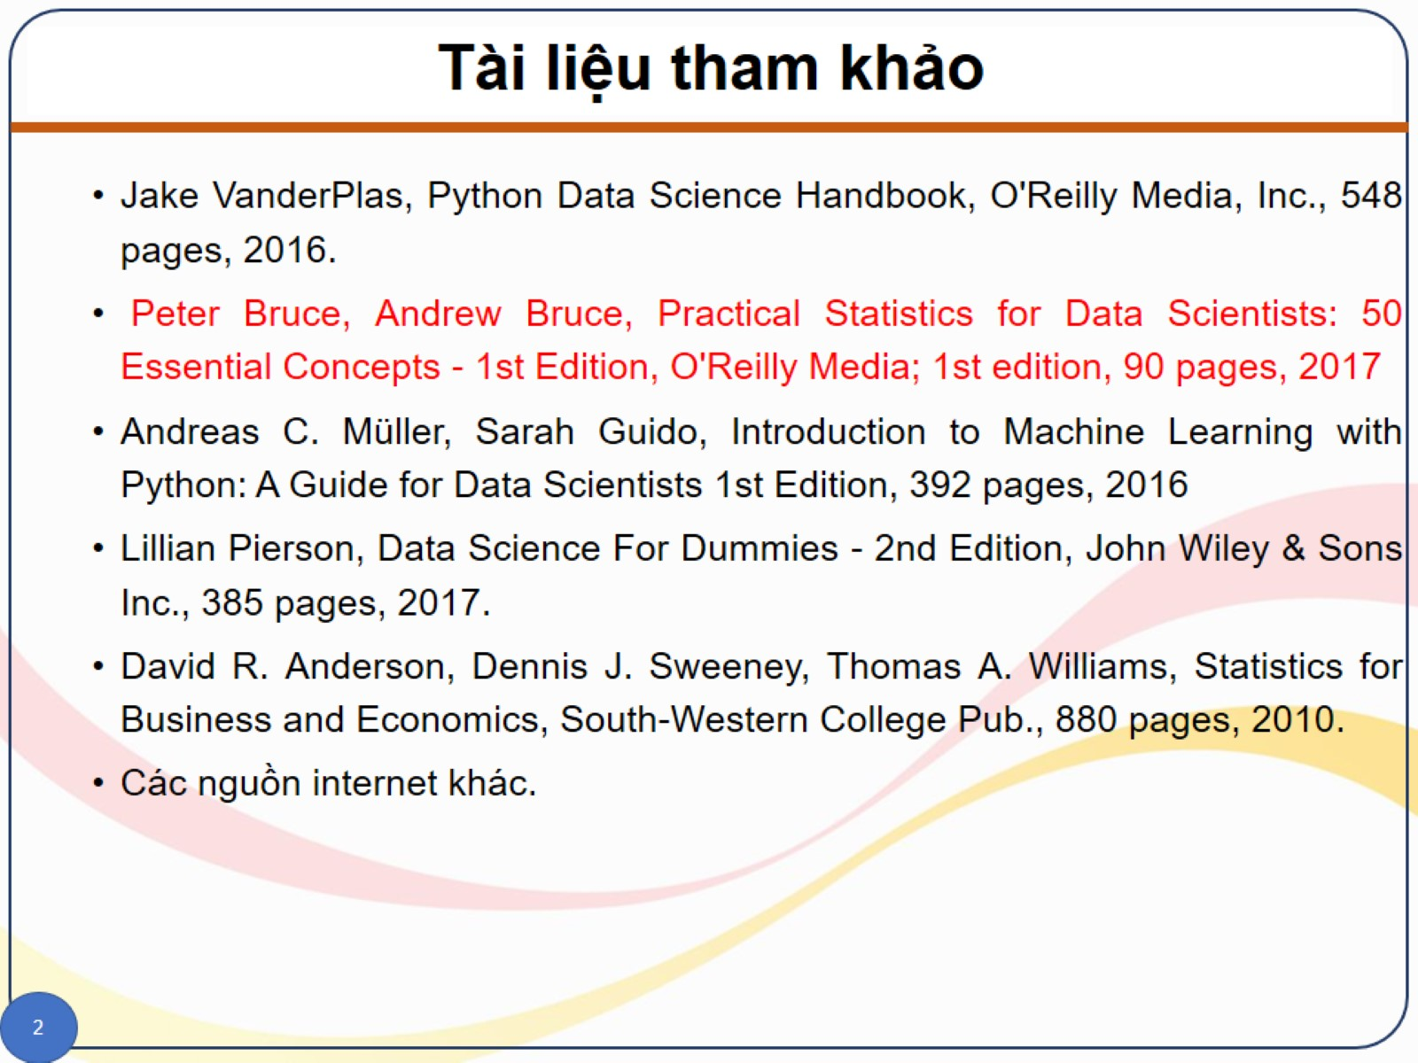
Tài liệu tham khảo

Slide 3
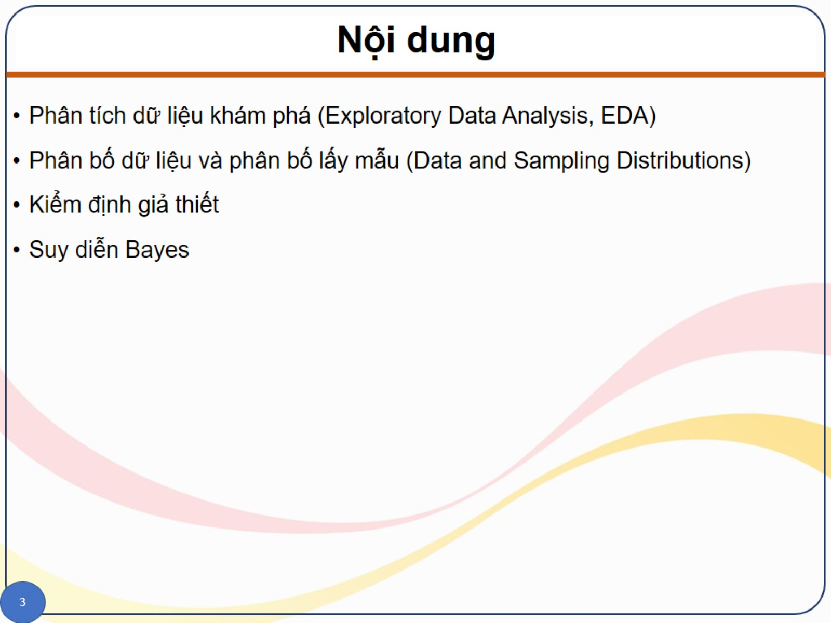
Nội dung

Slide 4
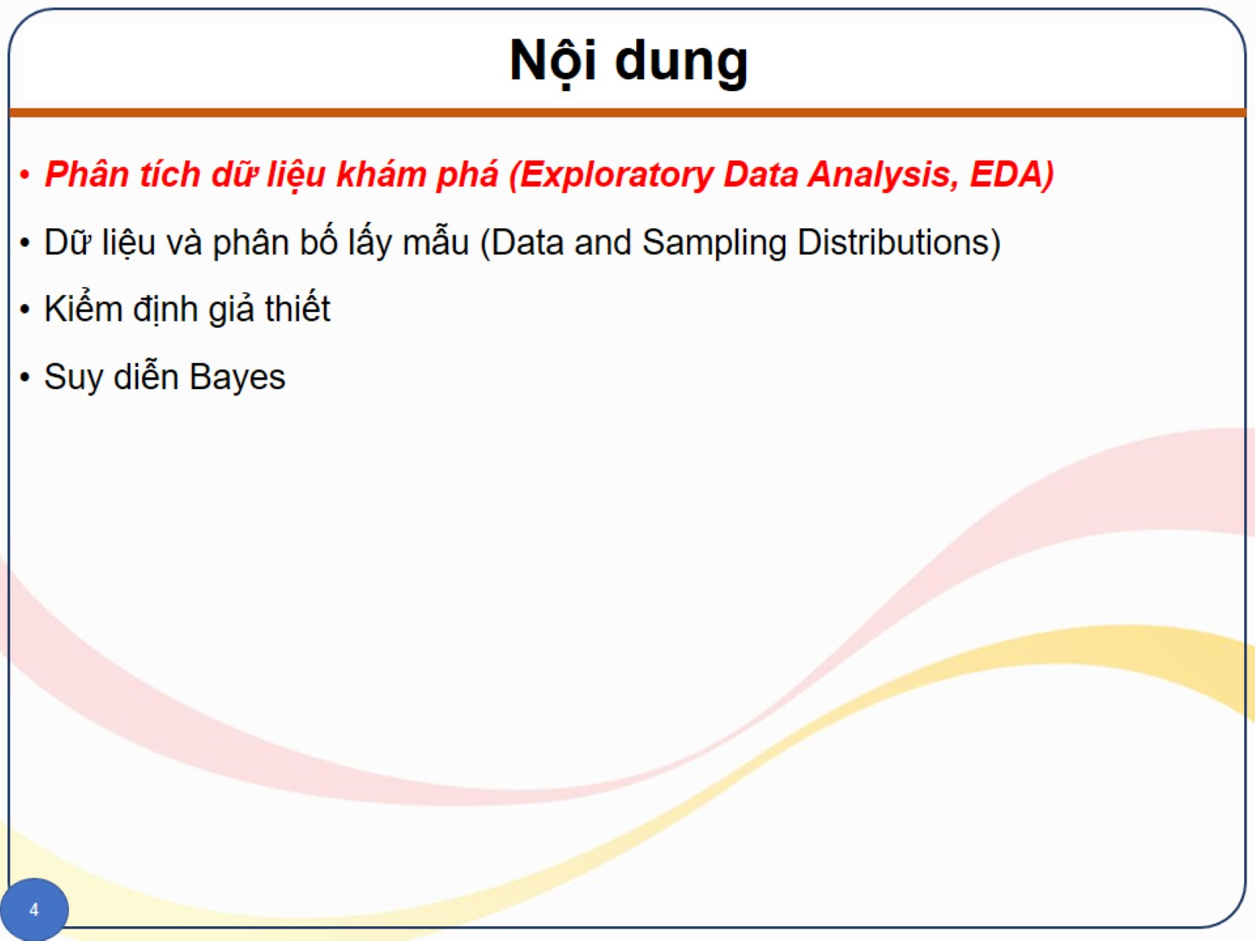
Nội dung

Slide 5
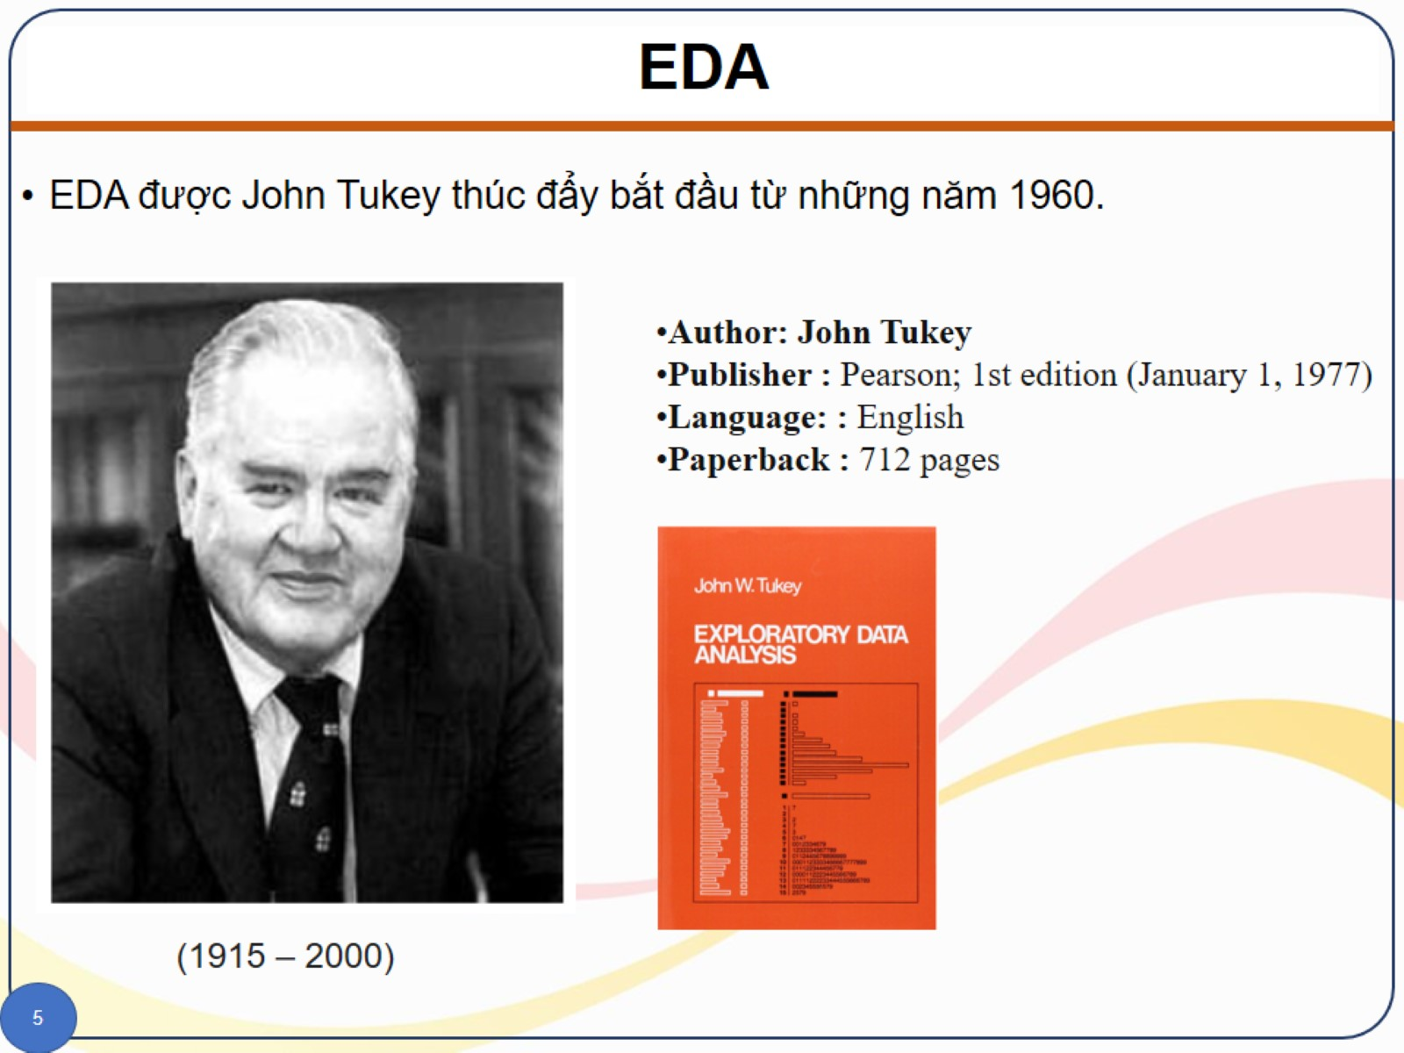
EDA

Slide 6
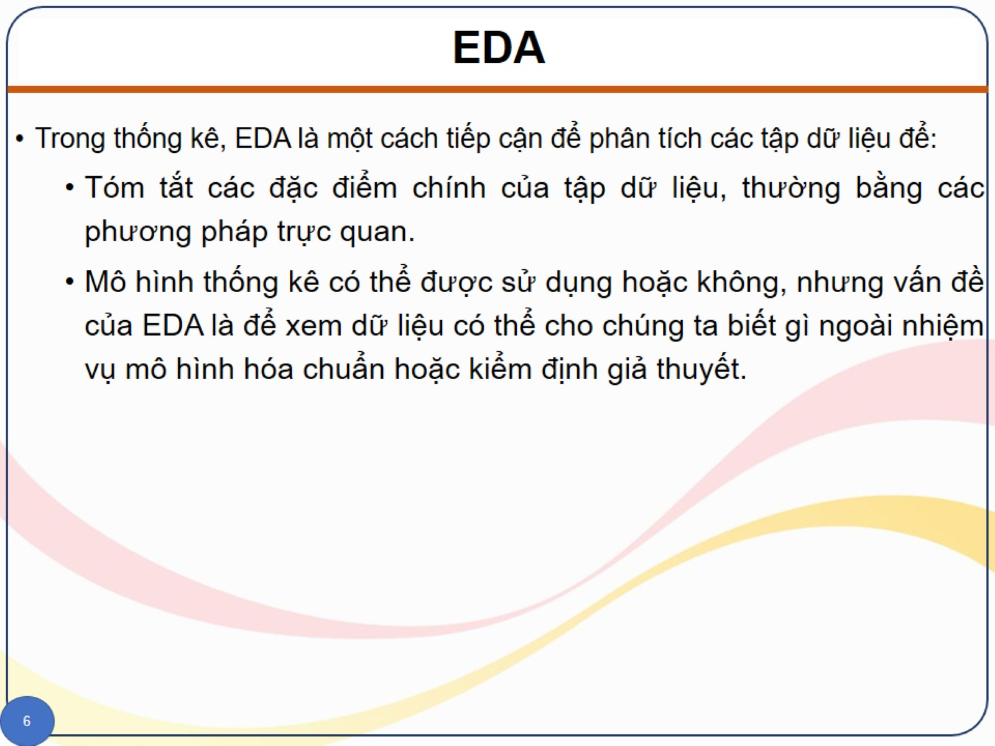
EDA

Slide 14
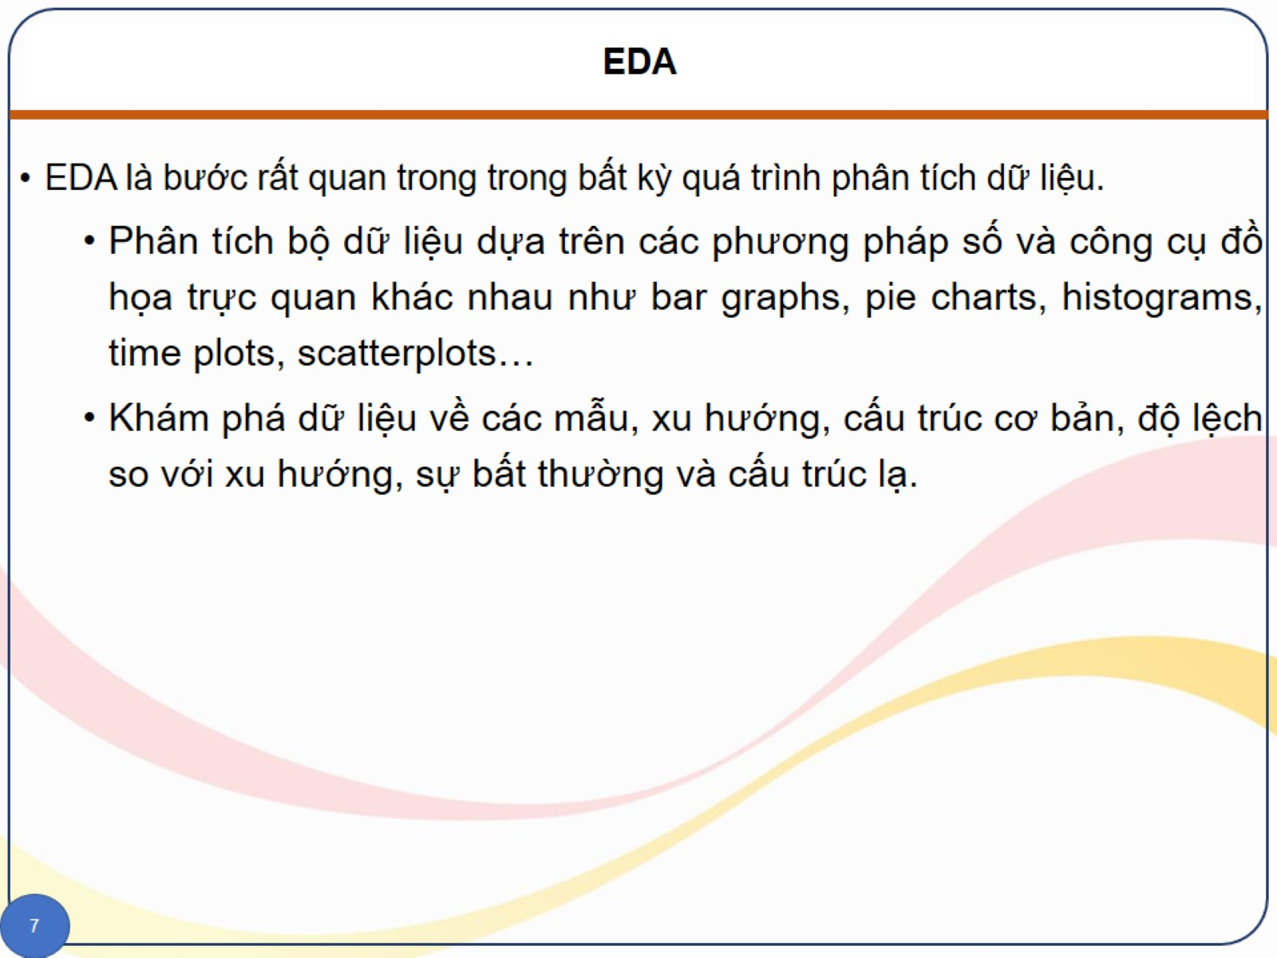
EDA

Slide 15
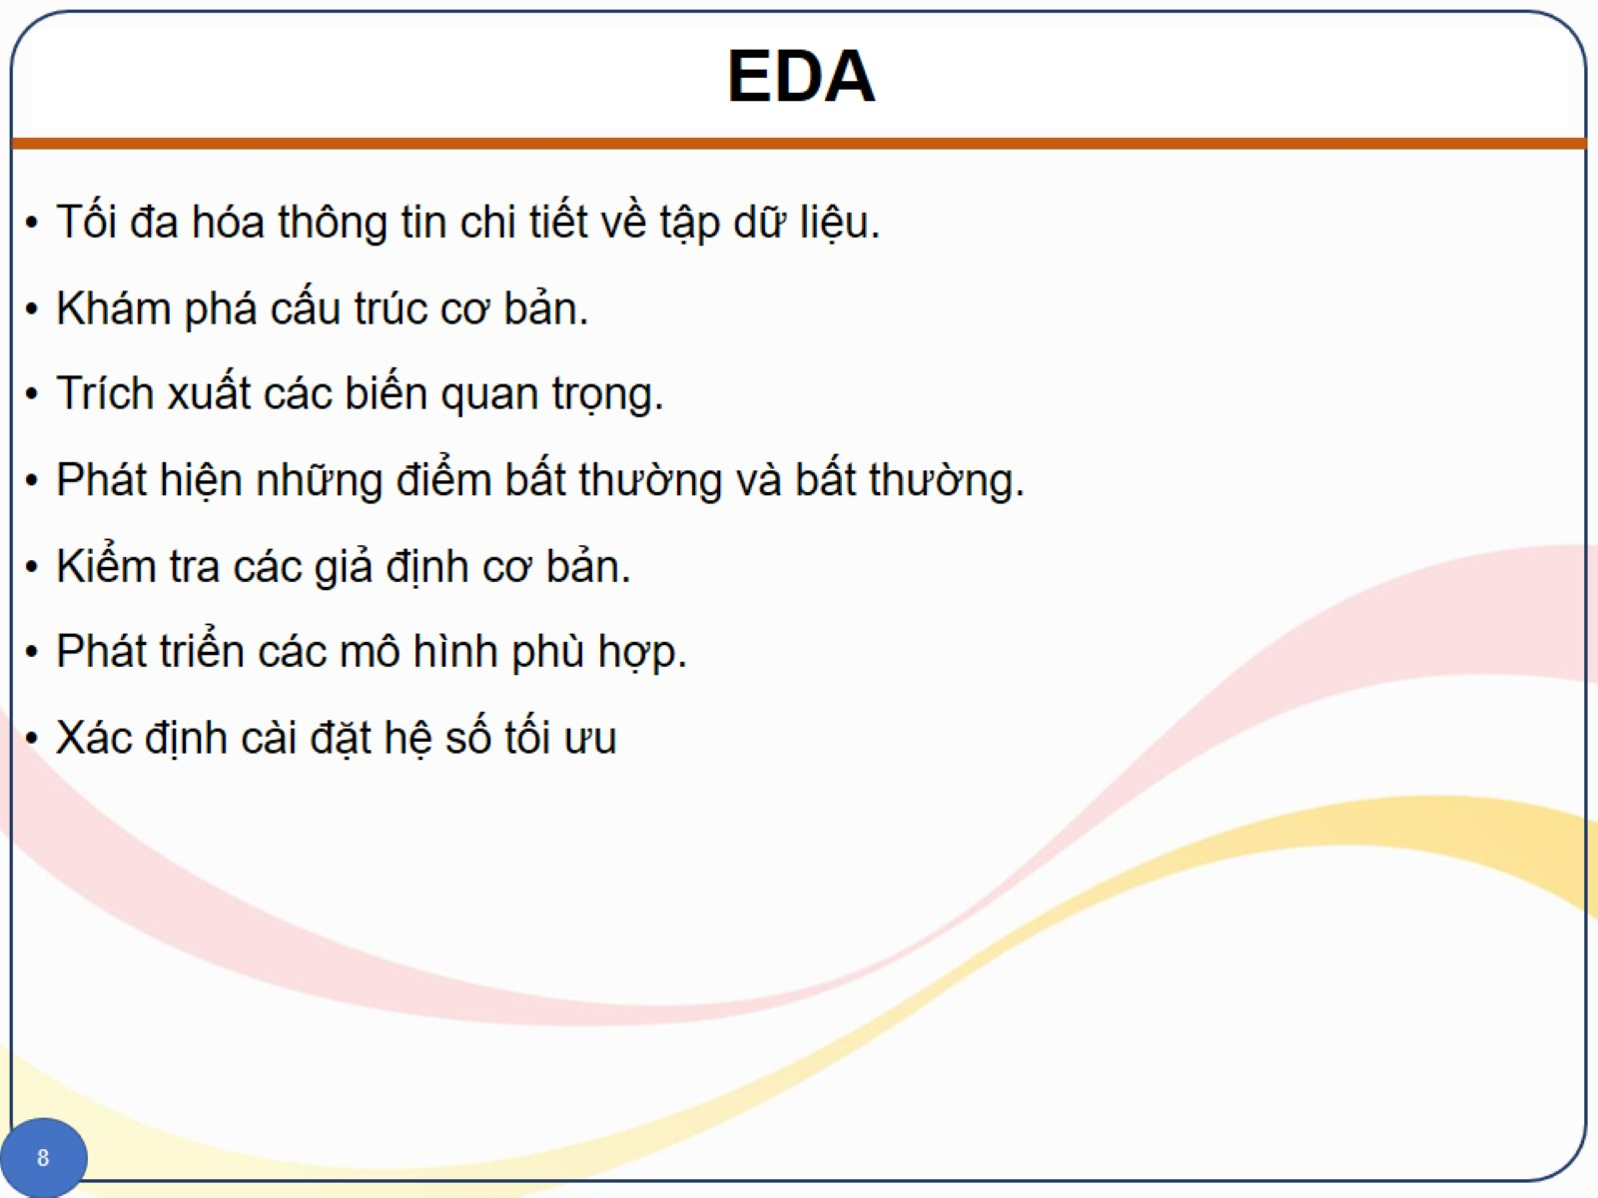
EDA

Slide 16
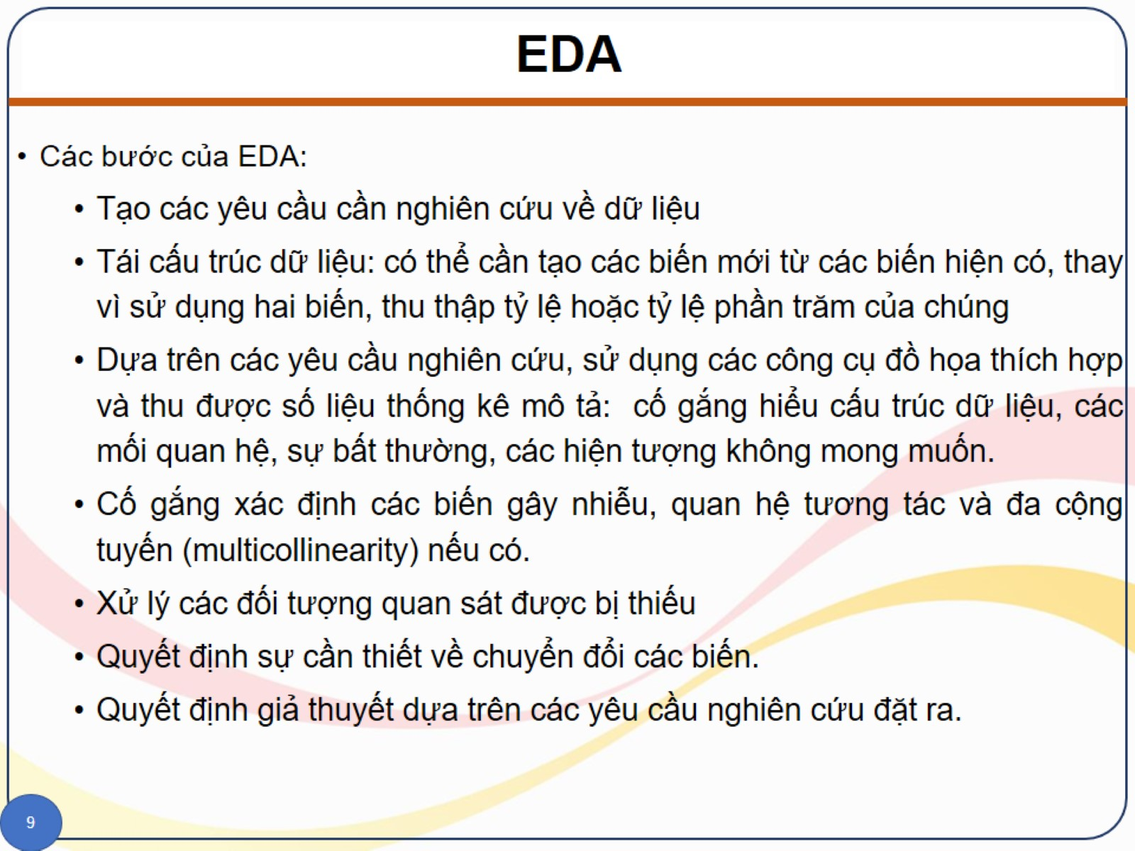
EDA

Slide 17
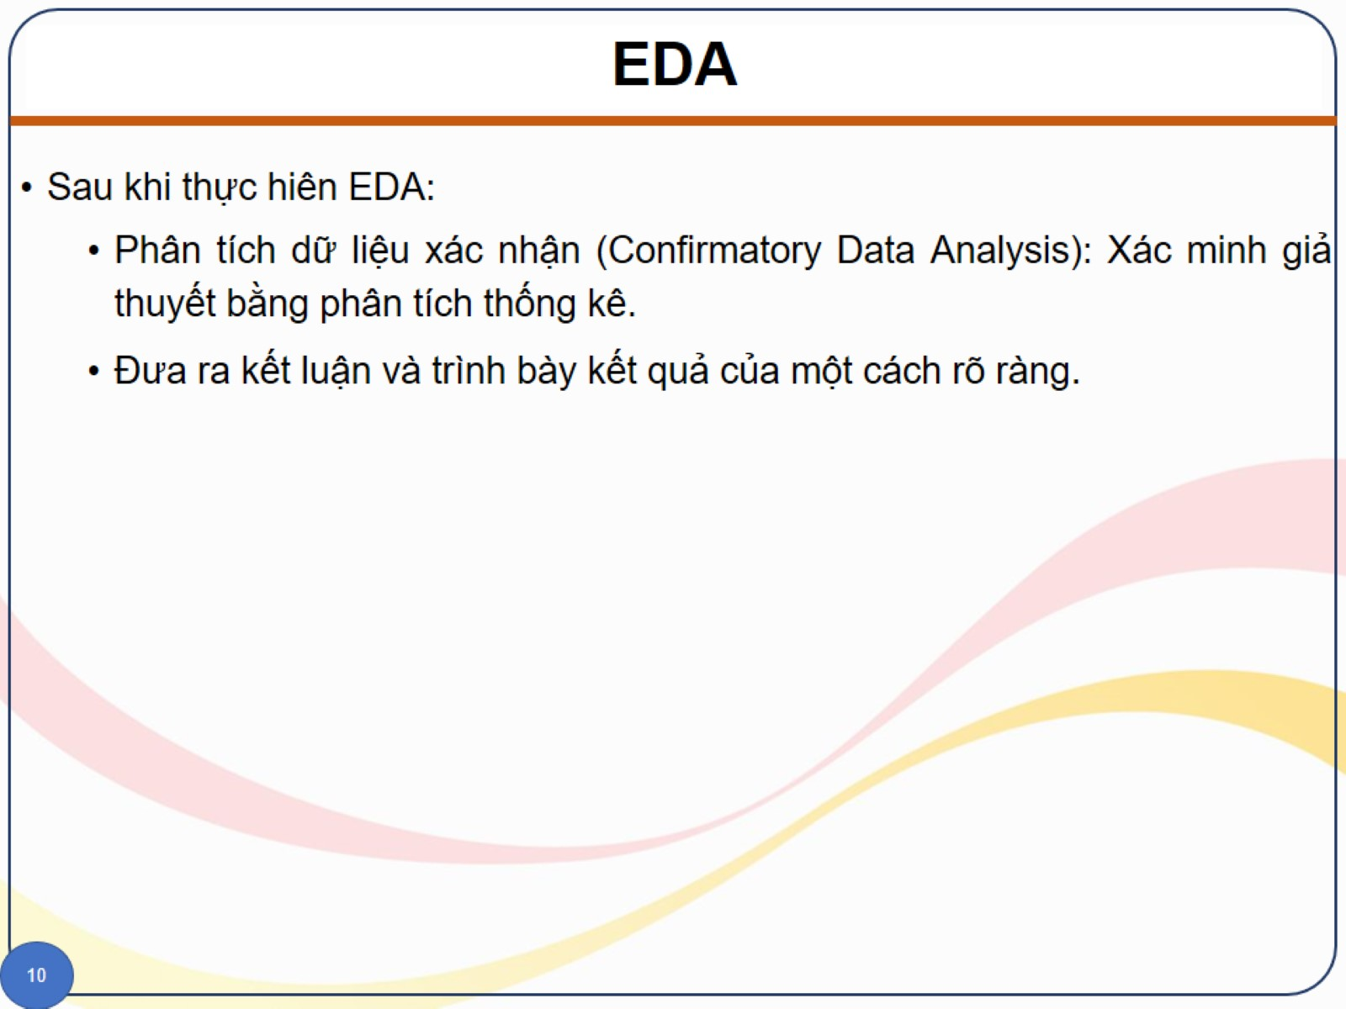
EDA

Slide 18
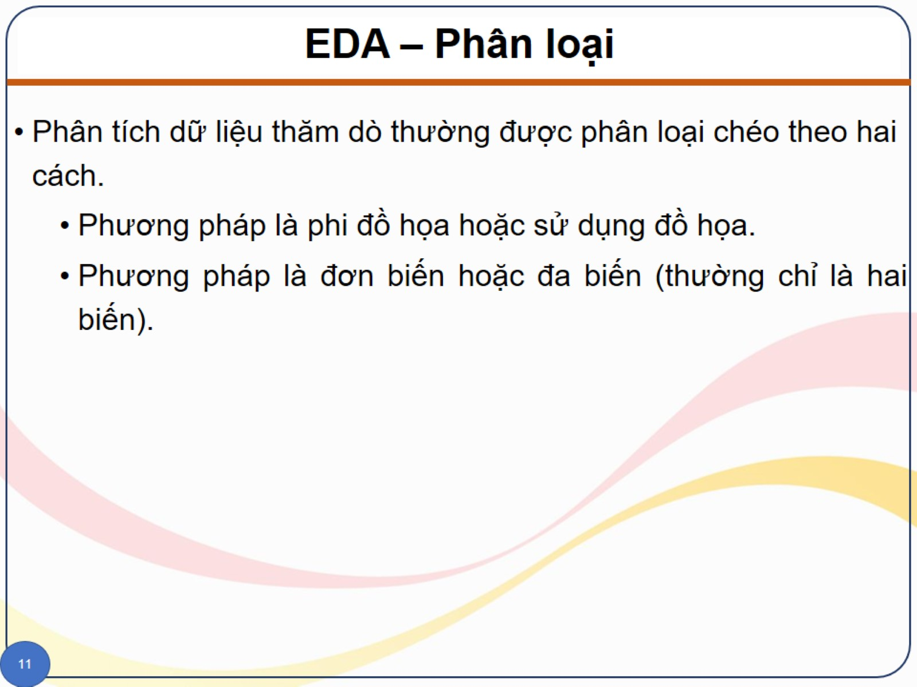
EDA – Phân loại

Slide 19
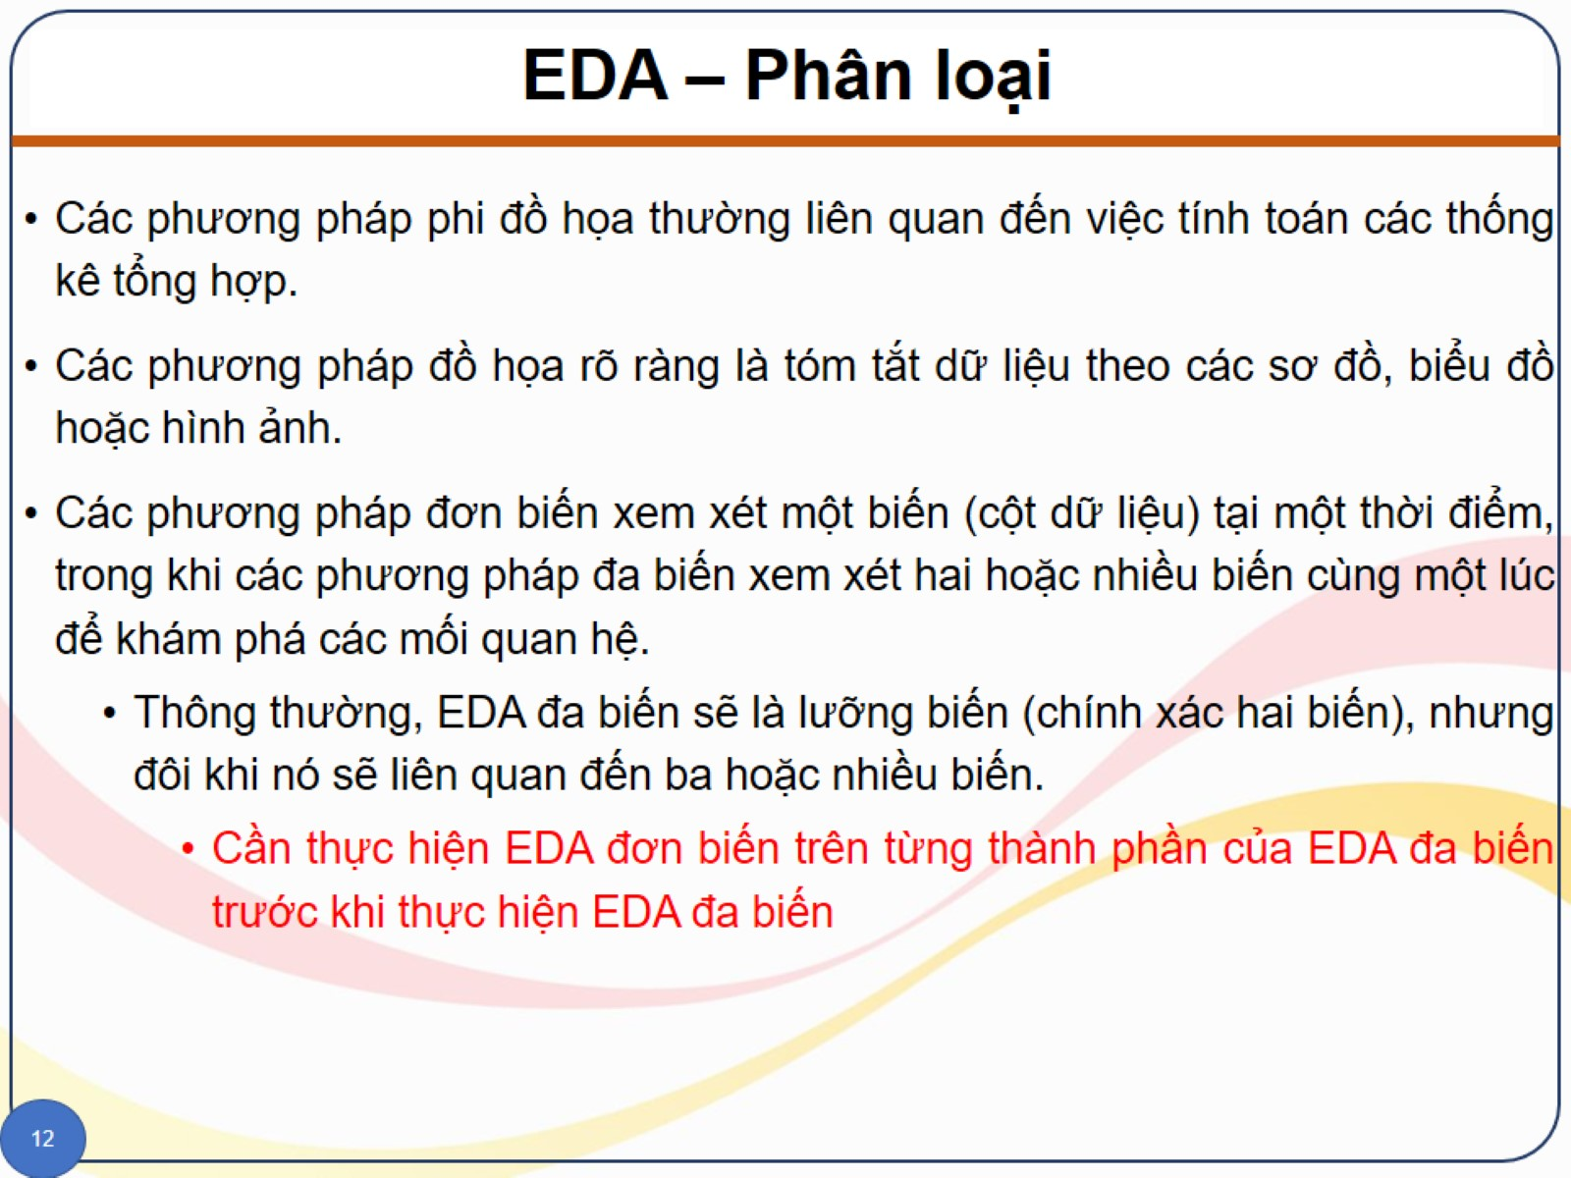
EDA – Phân loại

Slide 20
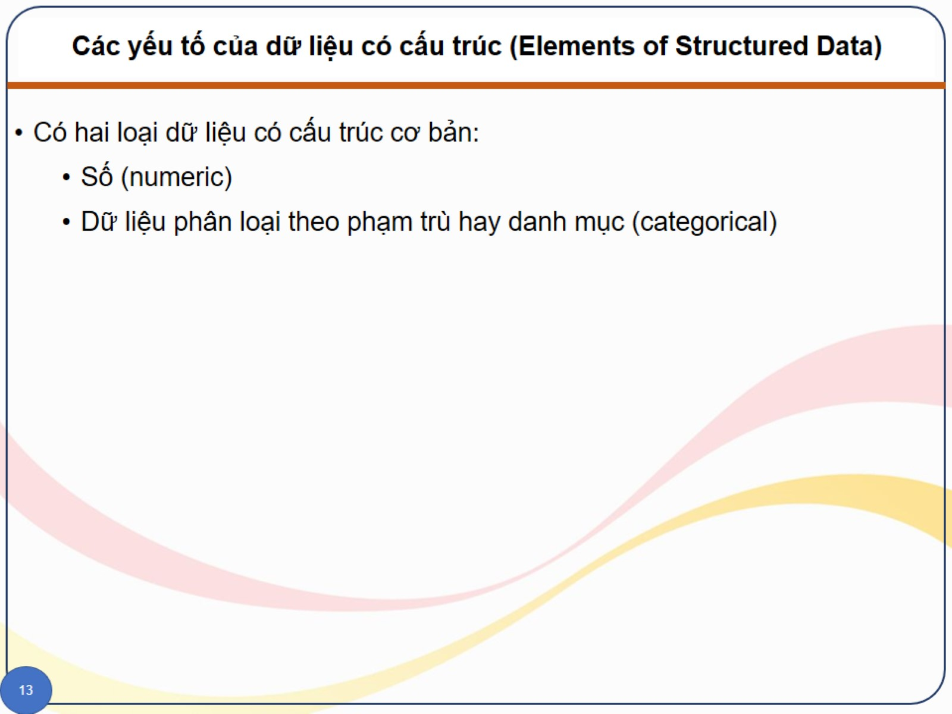
Các yếu tố của dữ liệu có cấu trúc (Elements of Structured Data)

Slide 21
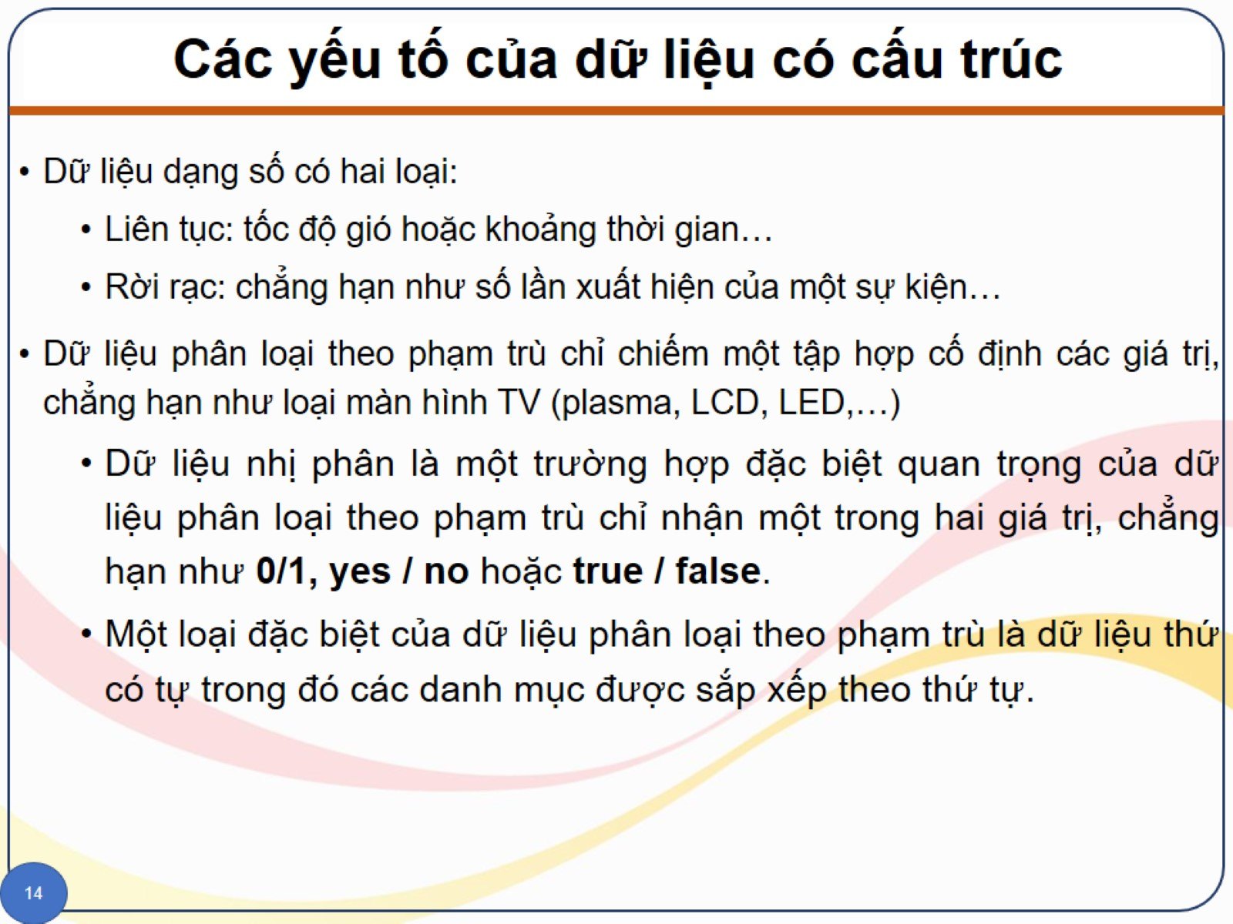
Các yếu tố của dữ liệu có cấu trúc

Slide 22
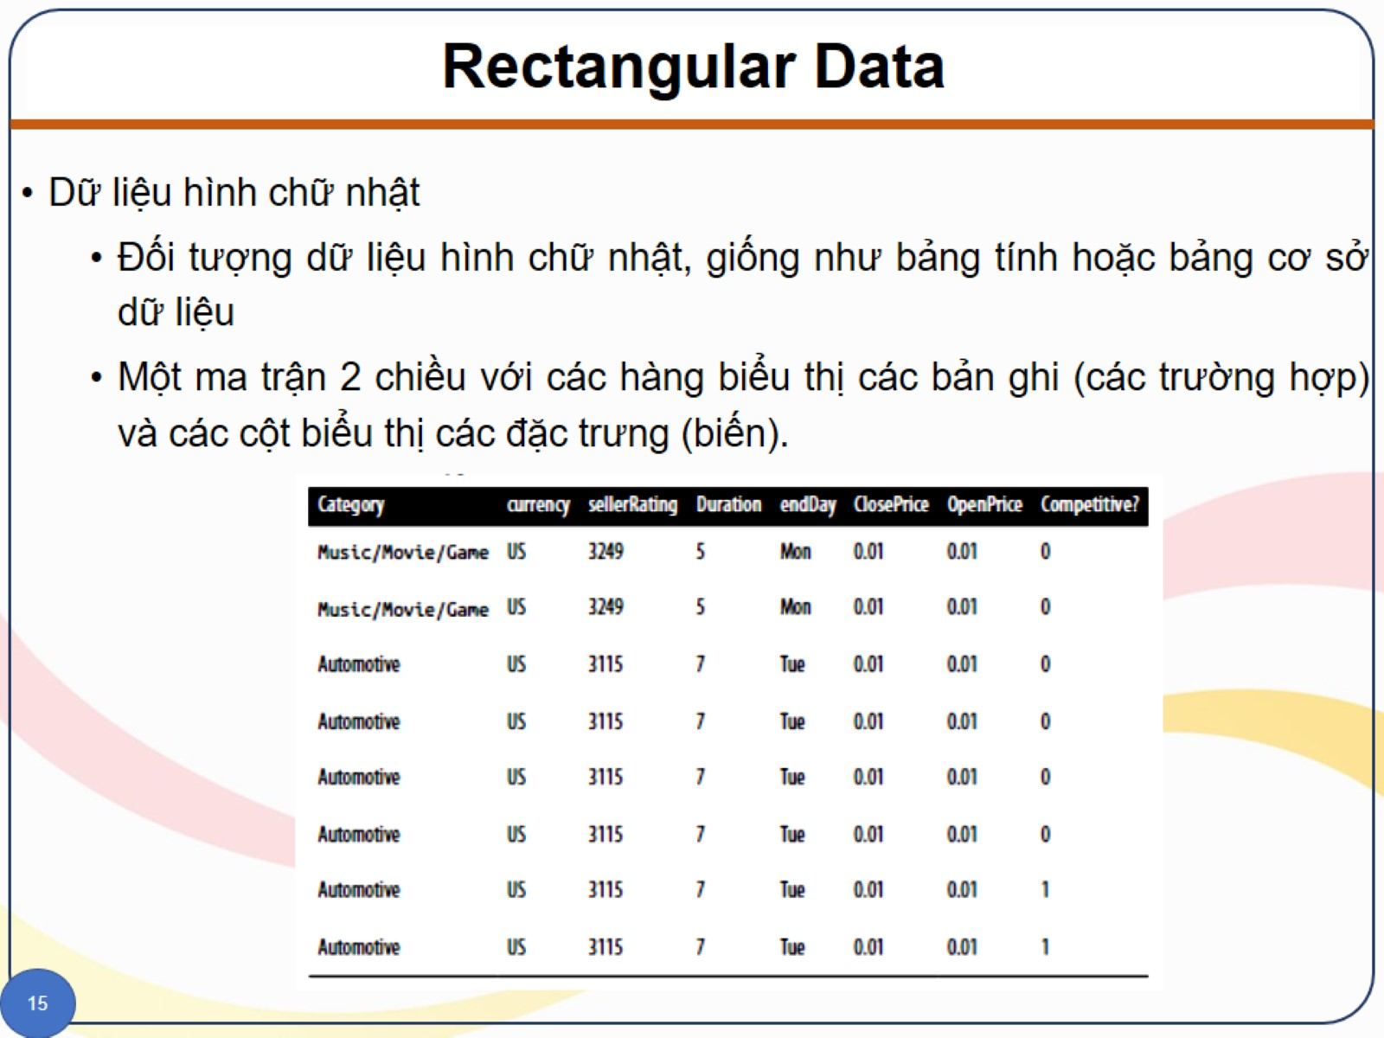
Rectangular Data

Slide 23
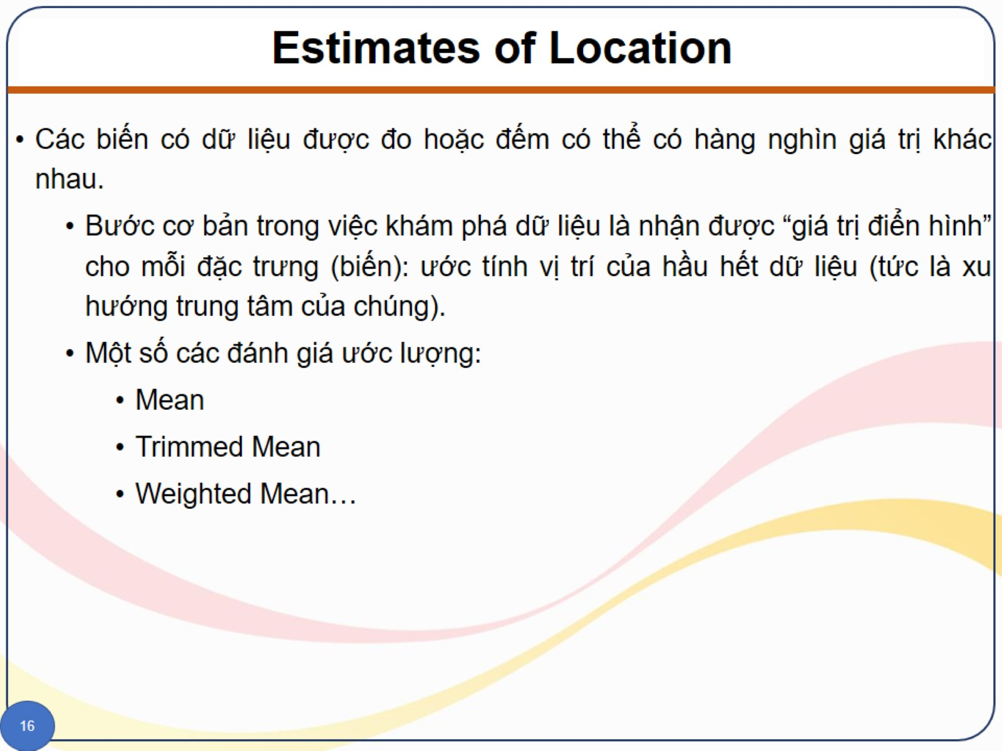
Estimates of Location

Slide 24
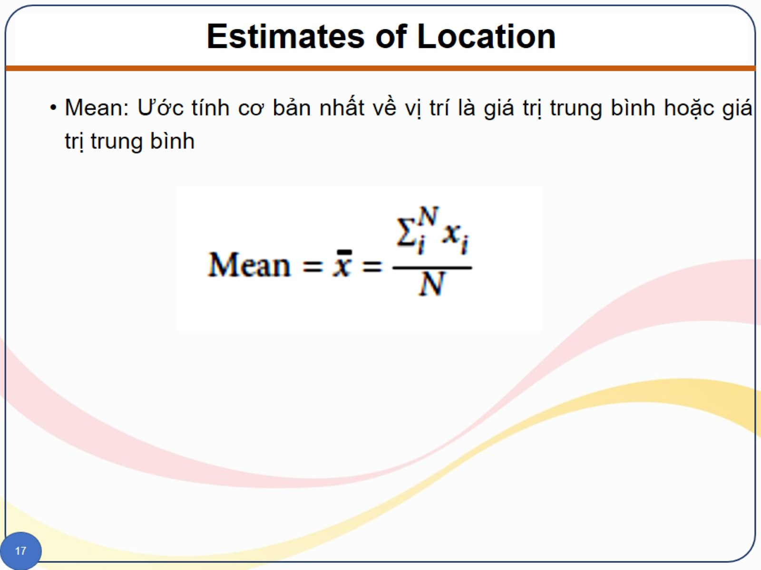
Estimates of Location

Slide 25
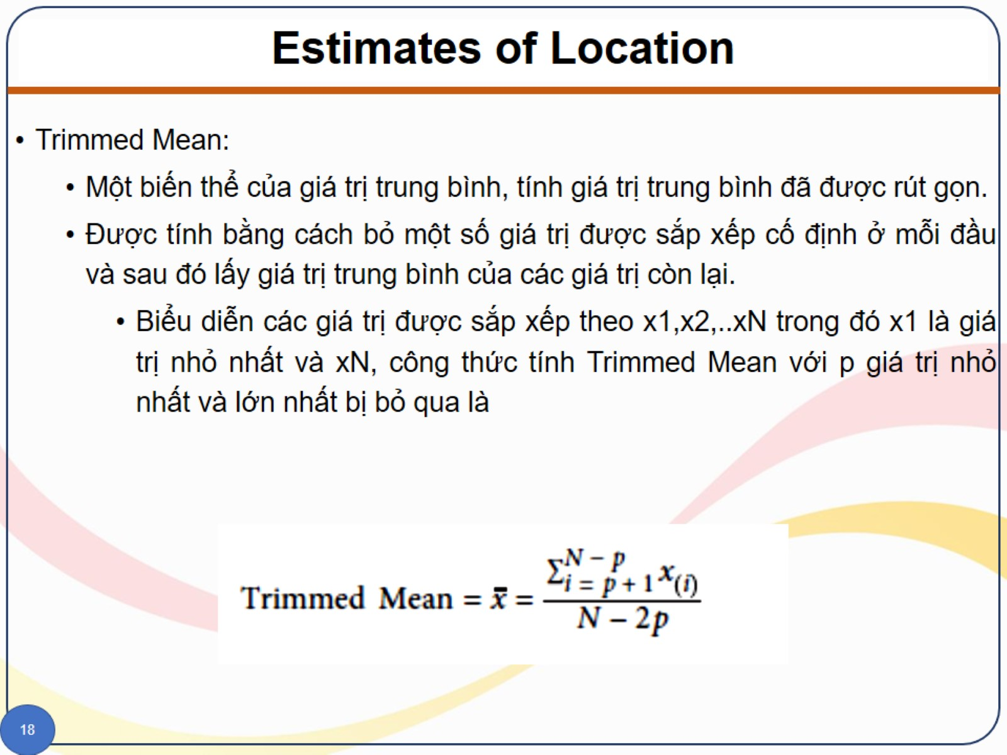
Estimates of Location

Slide 26
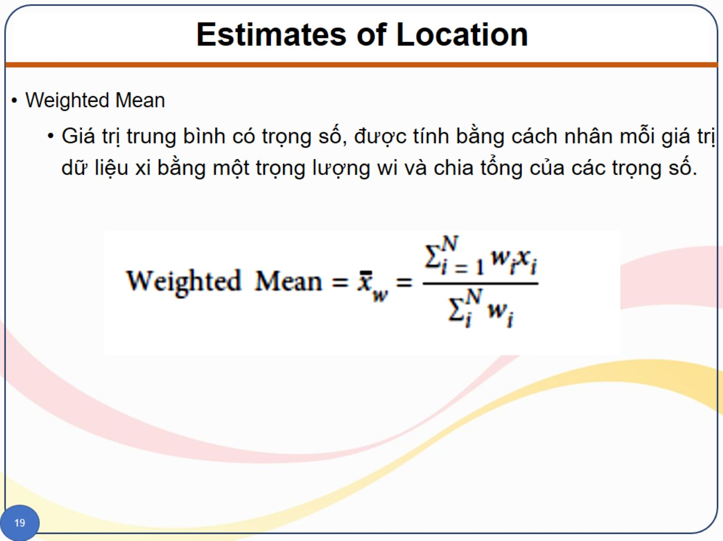
Estimates of Location

Slide 27
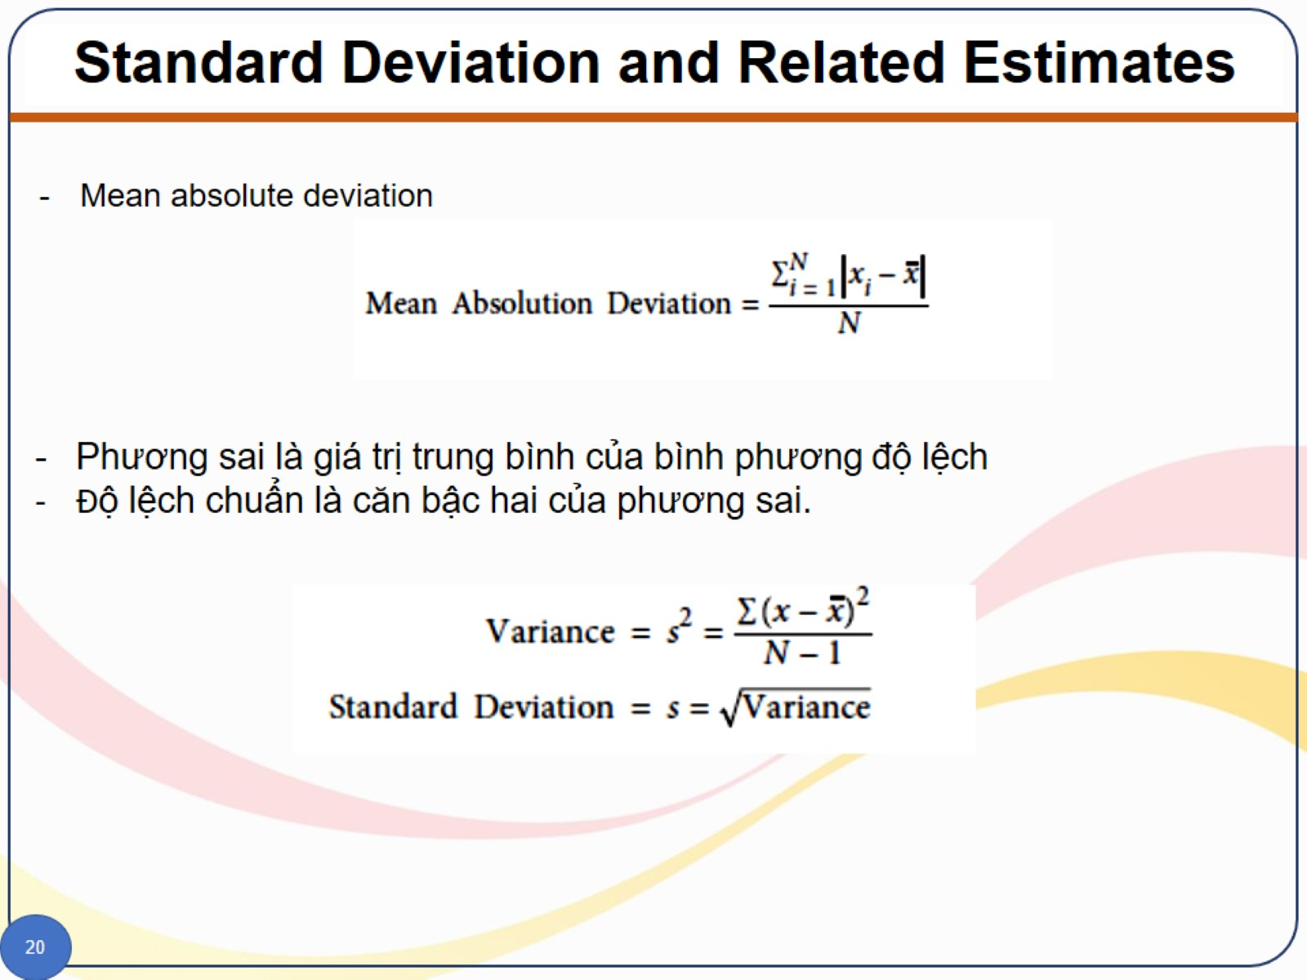
Standard Deviation and Related Estimates

Slide 28
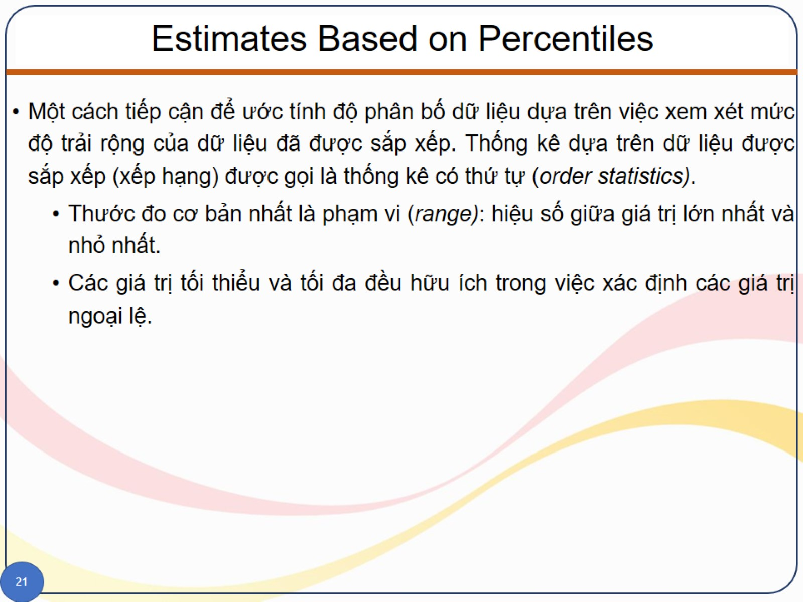
Estimates Based on Percentiles

Slide 29
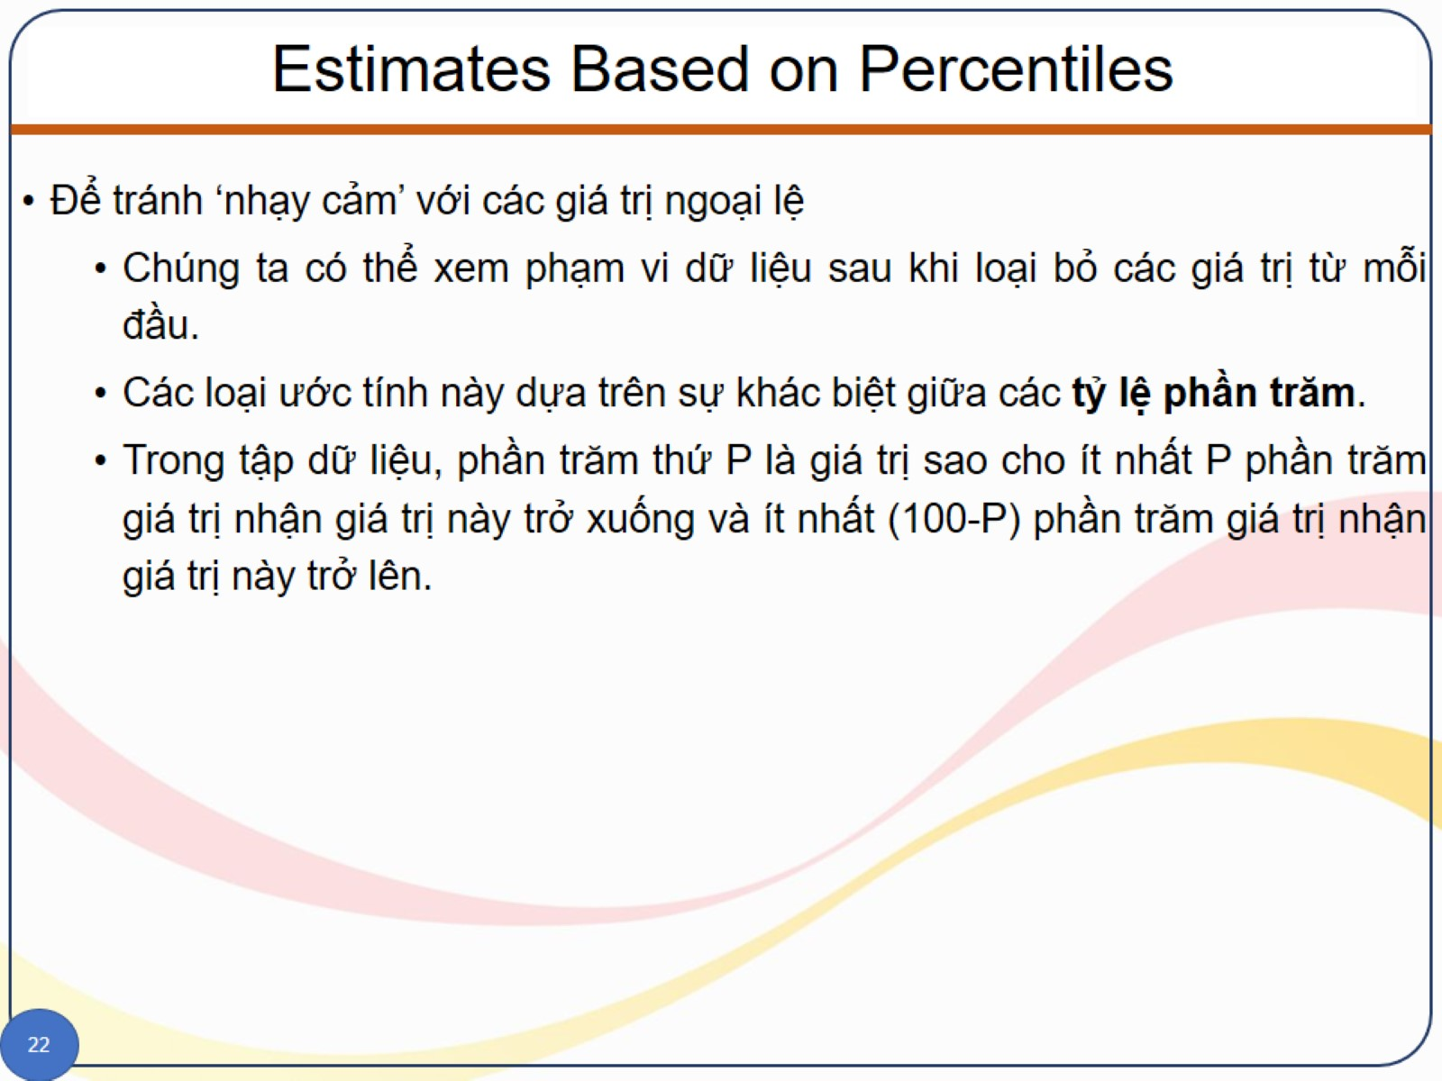
Estimates Based on Percentiles

Slide 30
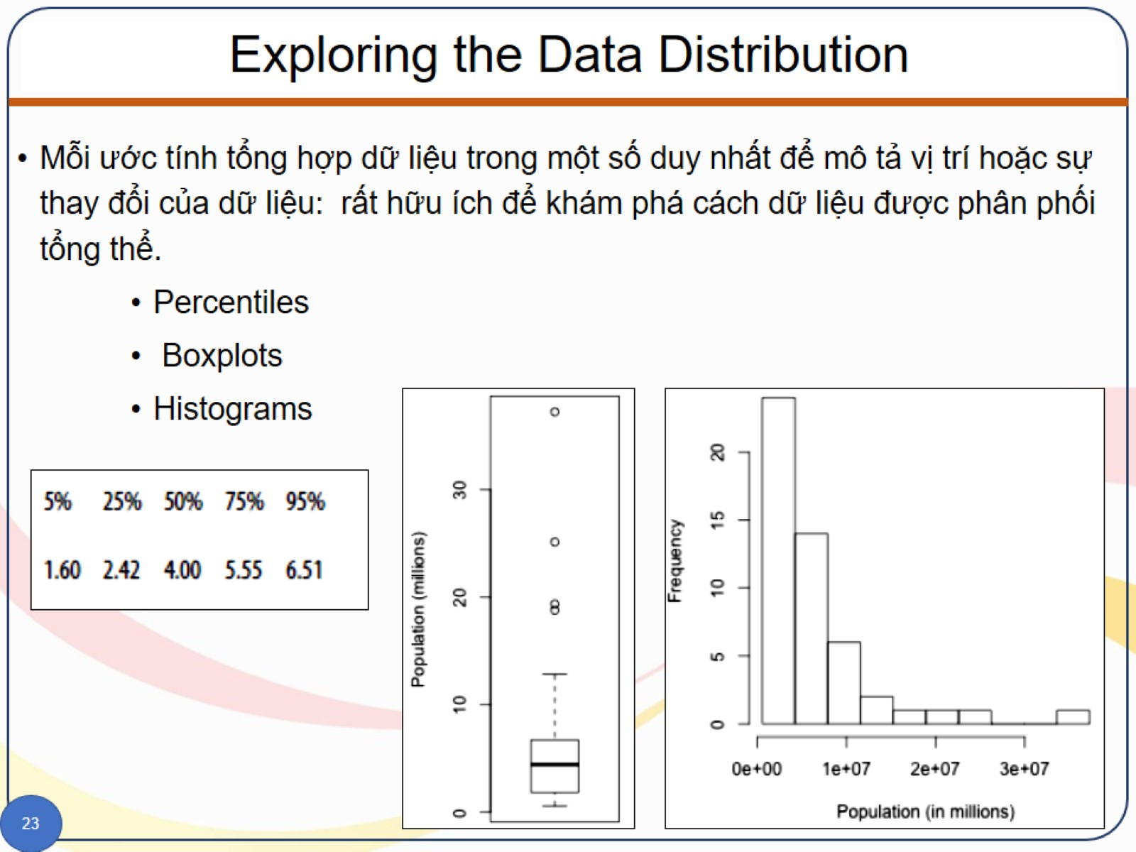
Exploring the Data Distribution

Slide 31
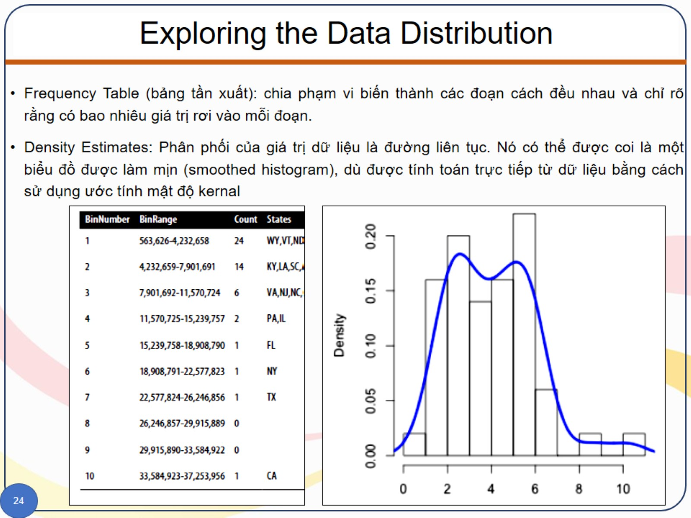
Exploring the Data Distribution

Slide 32
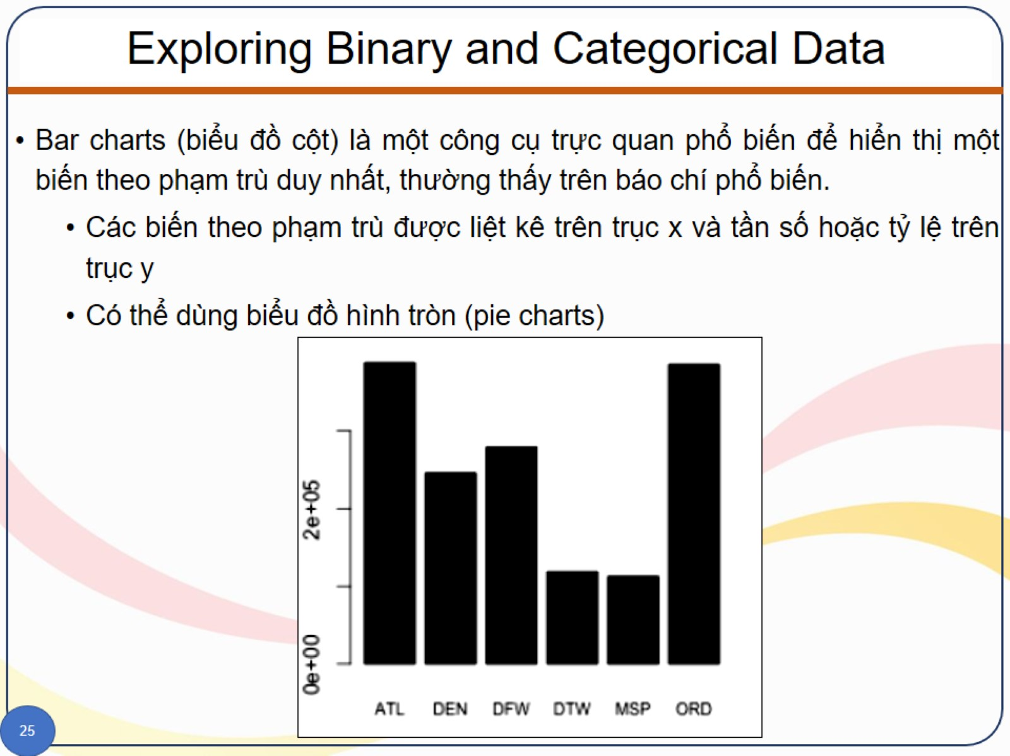
Exploring Binary and Categorical Data

Slide 33
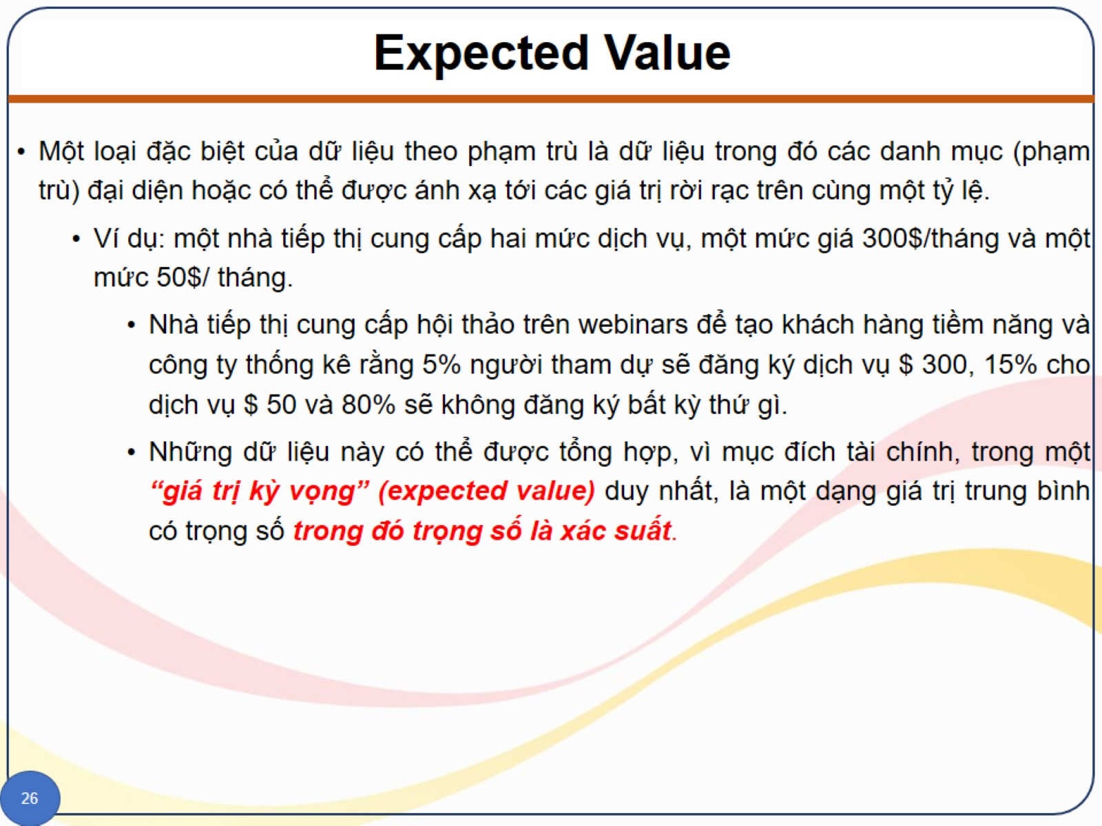
Expected Value

Slide 34
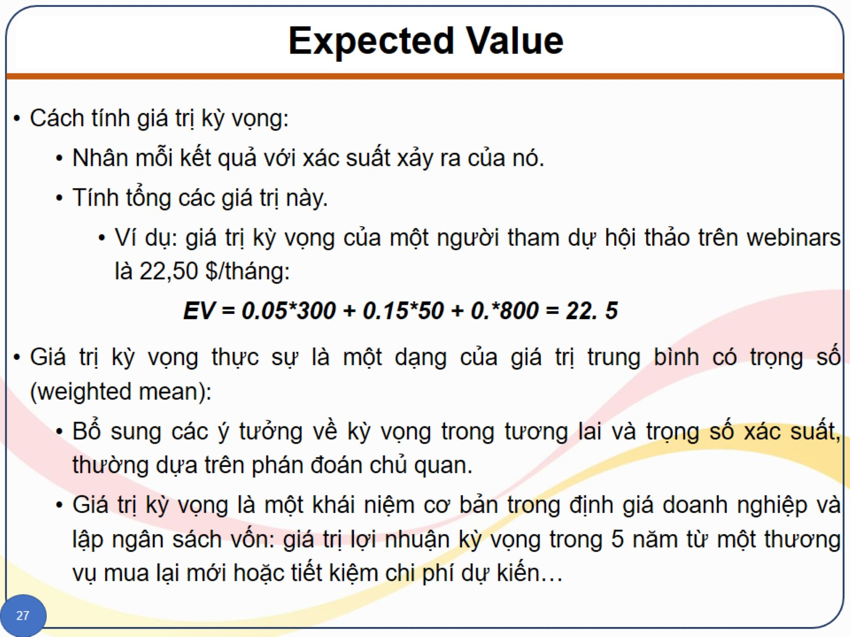
Expected Value

Slide 35
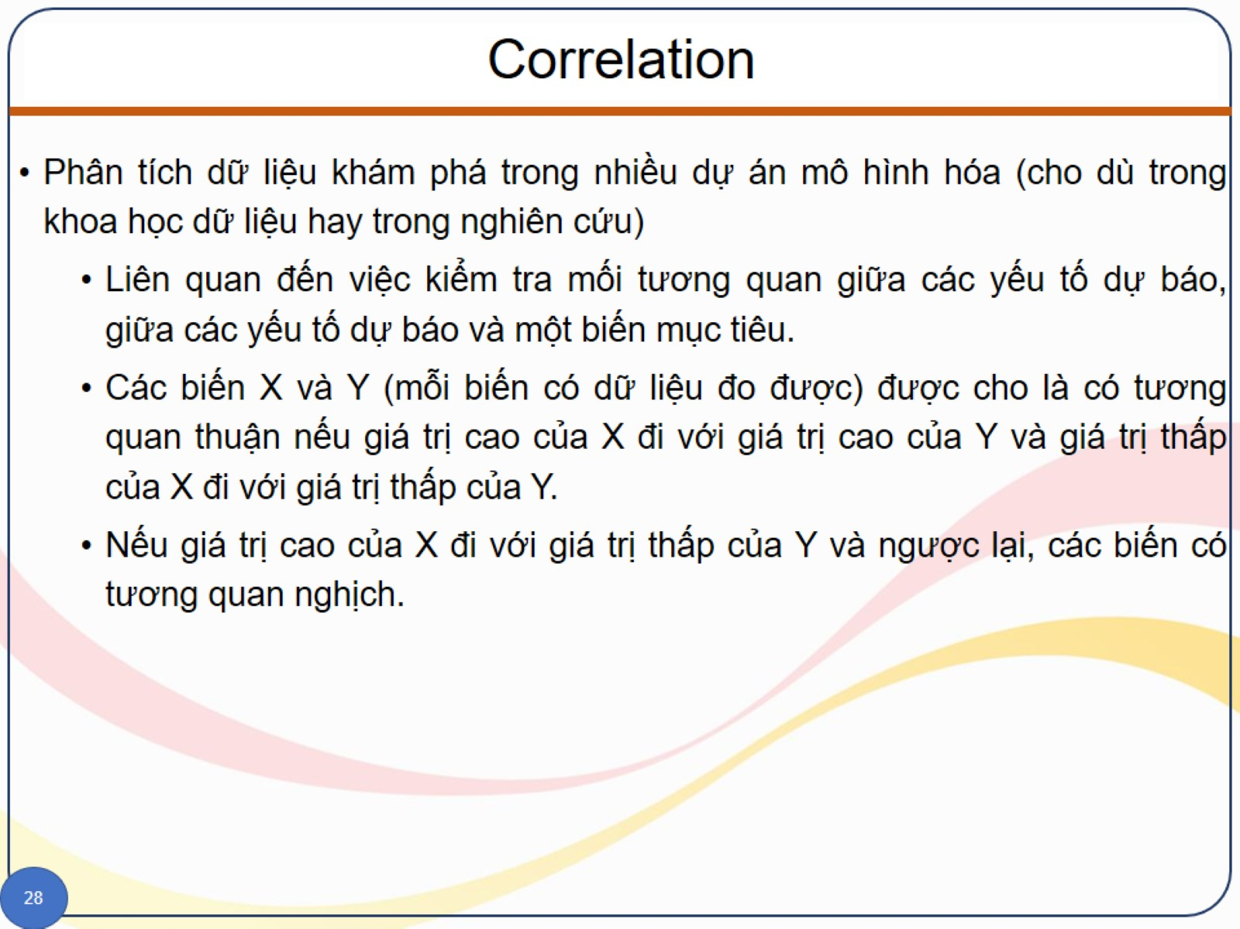
Correlation

Slide 36
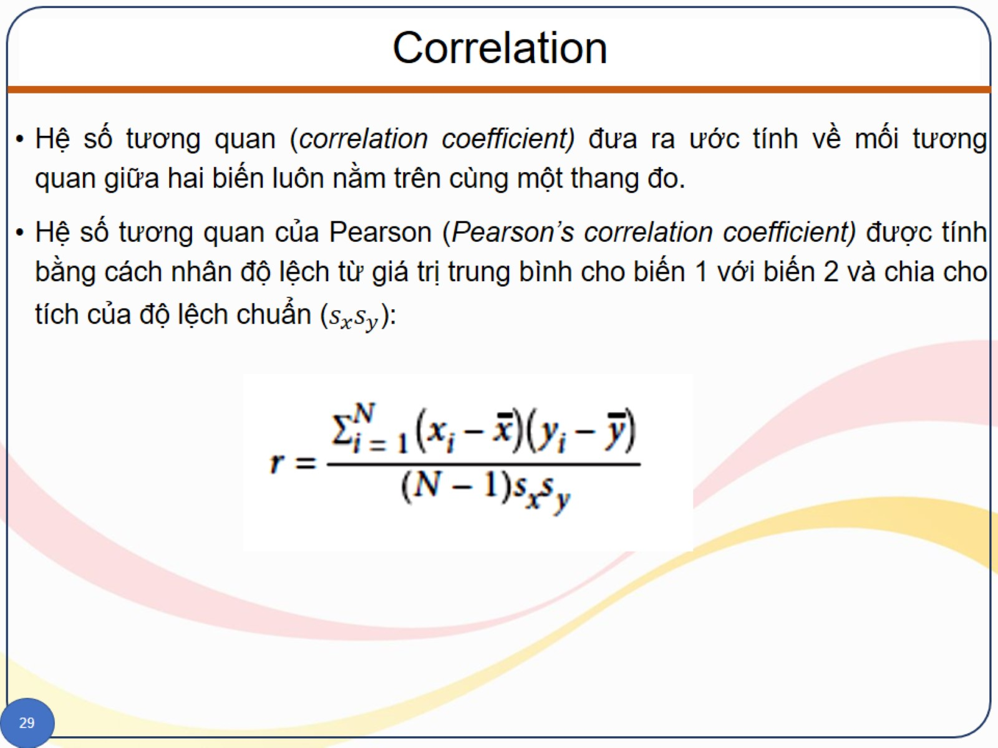
Correlation

Slide 37
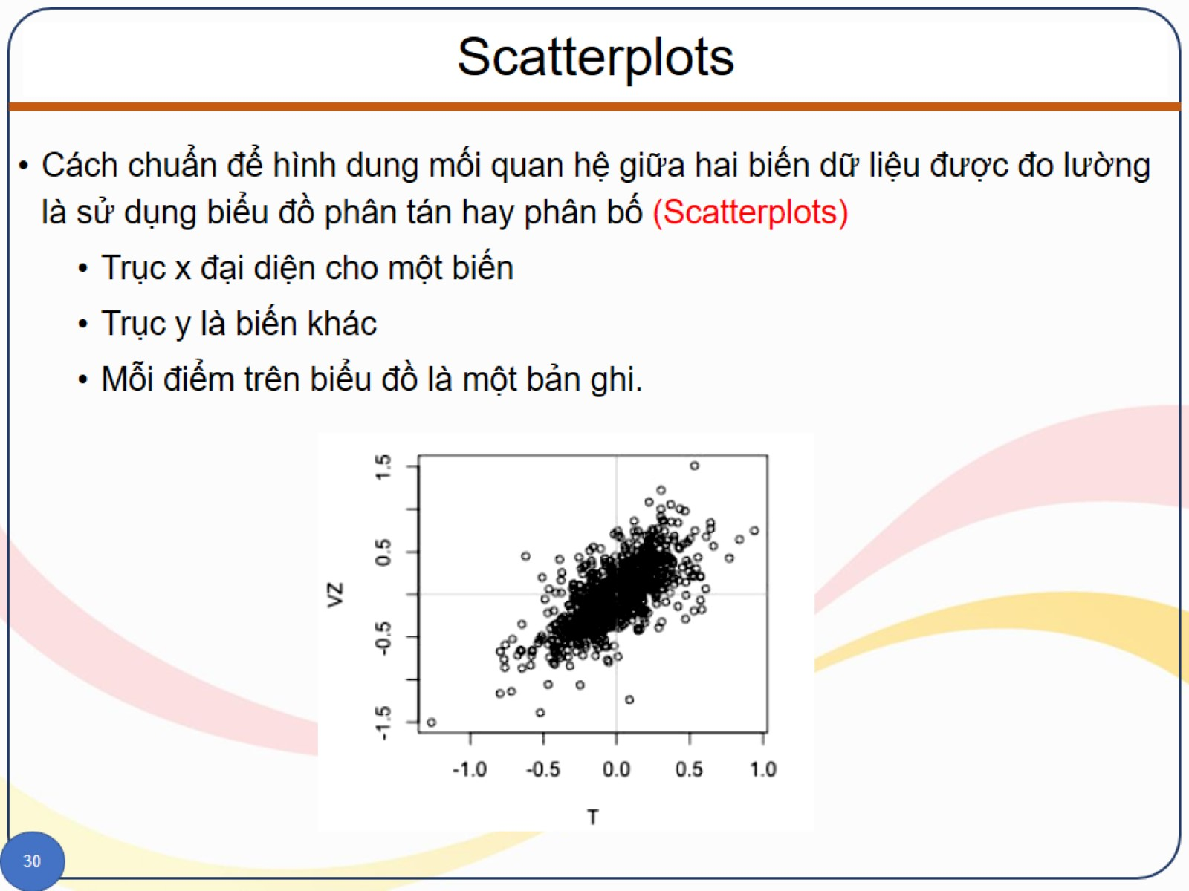
Scatterplots

Slide 38
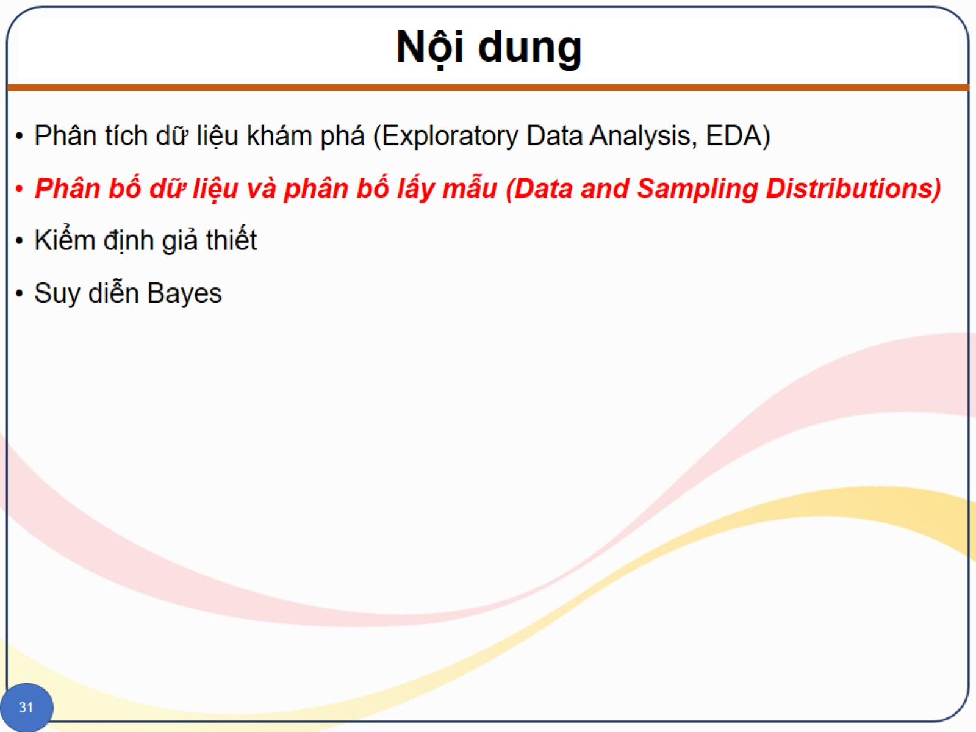
Nội dung

Slide 39
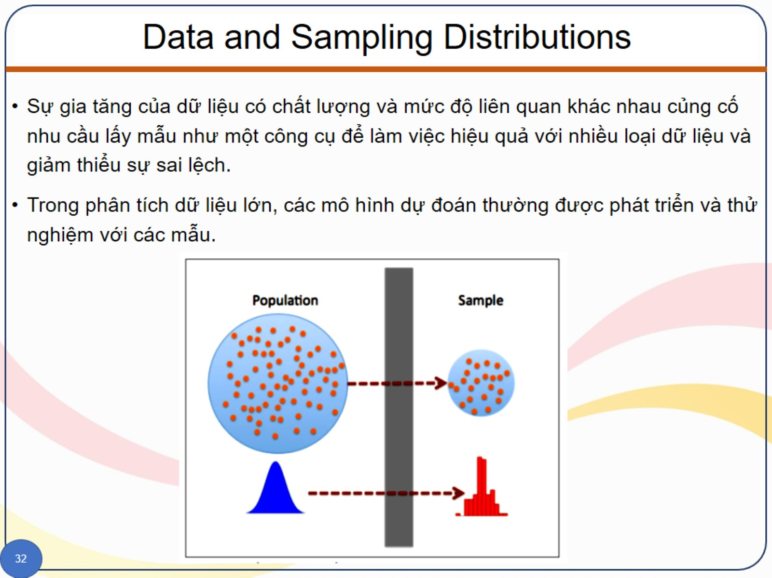
Data and Sampling Distributions

Slide 40
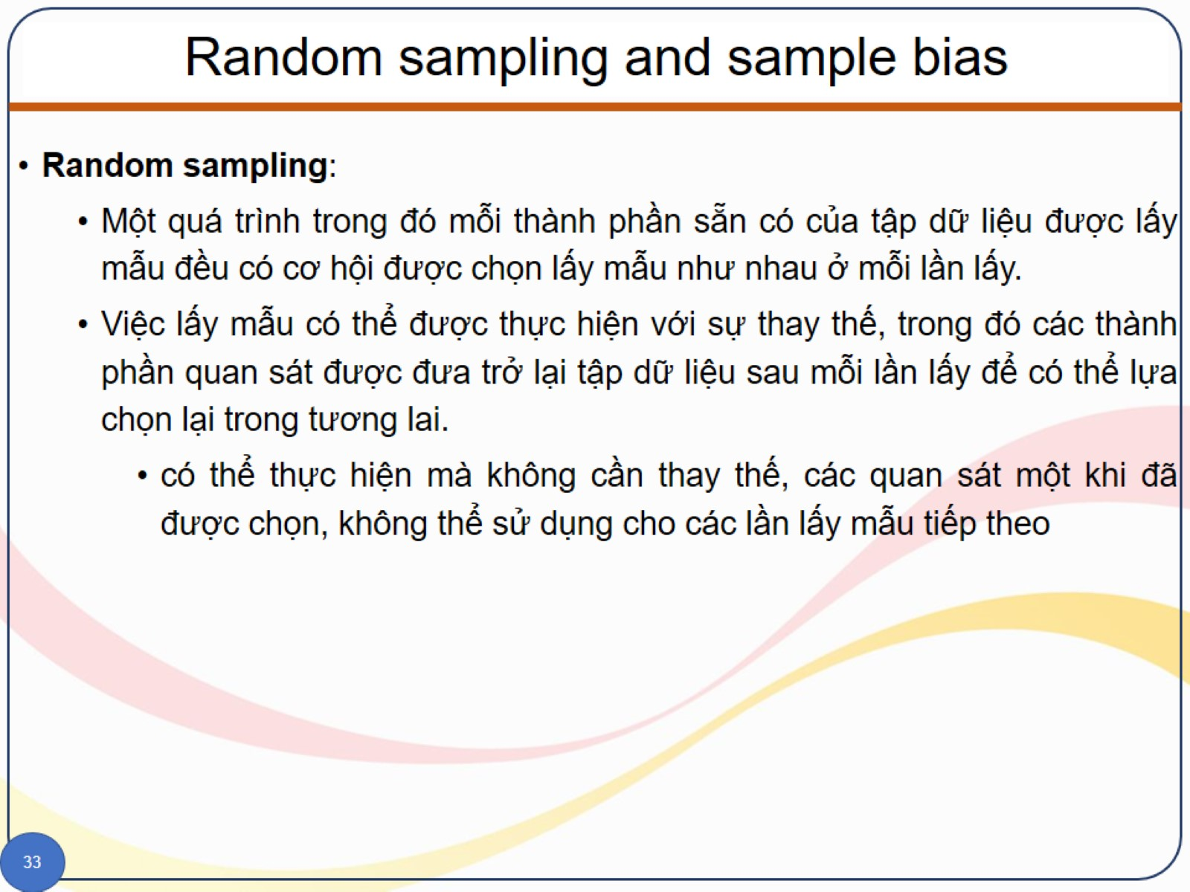
Random sampling and sample bias

Slide 41
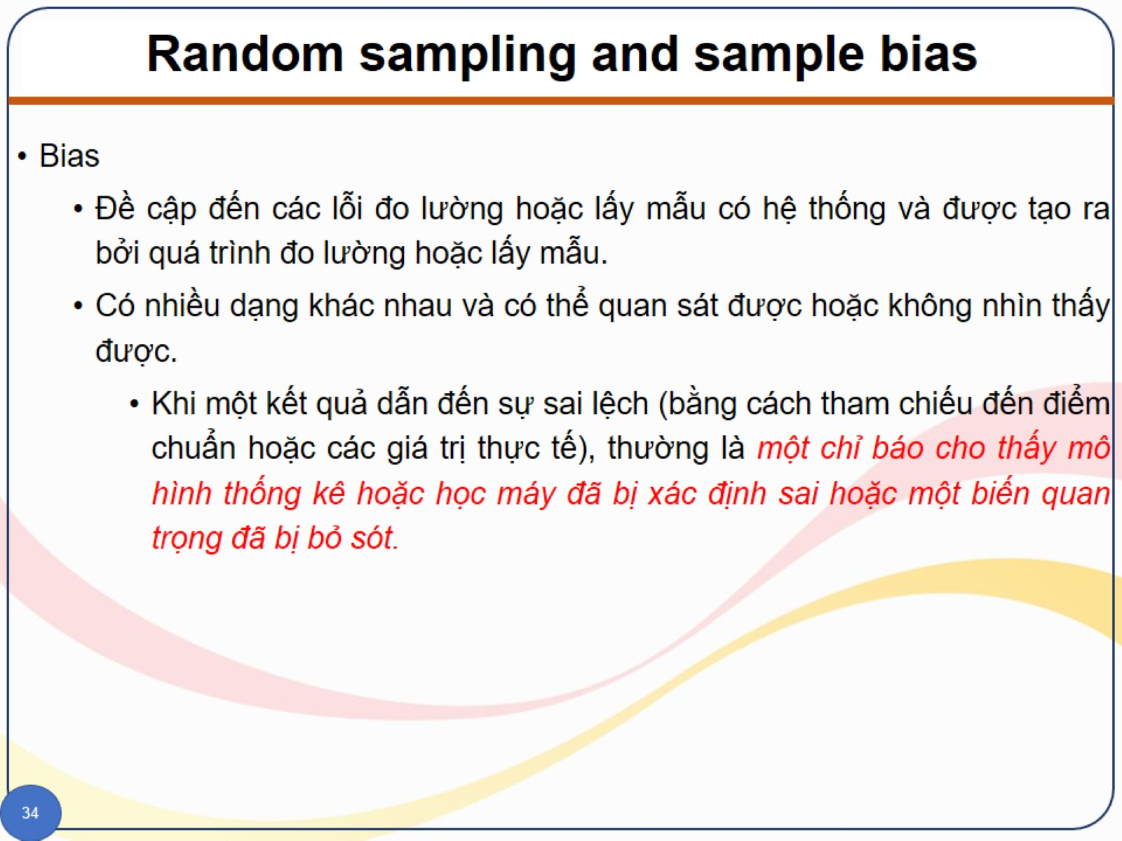
Random sampling and sample bias

Slide 42
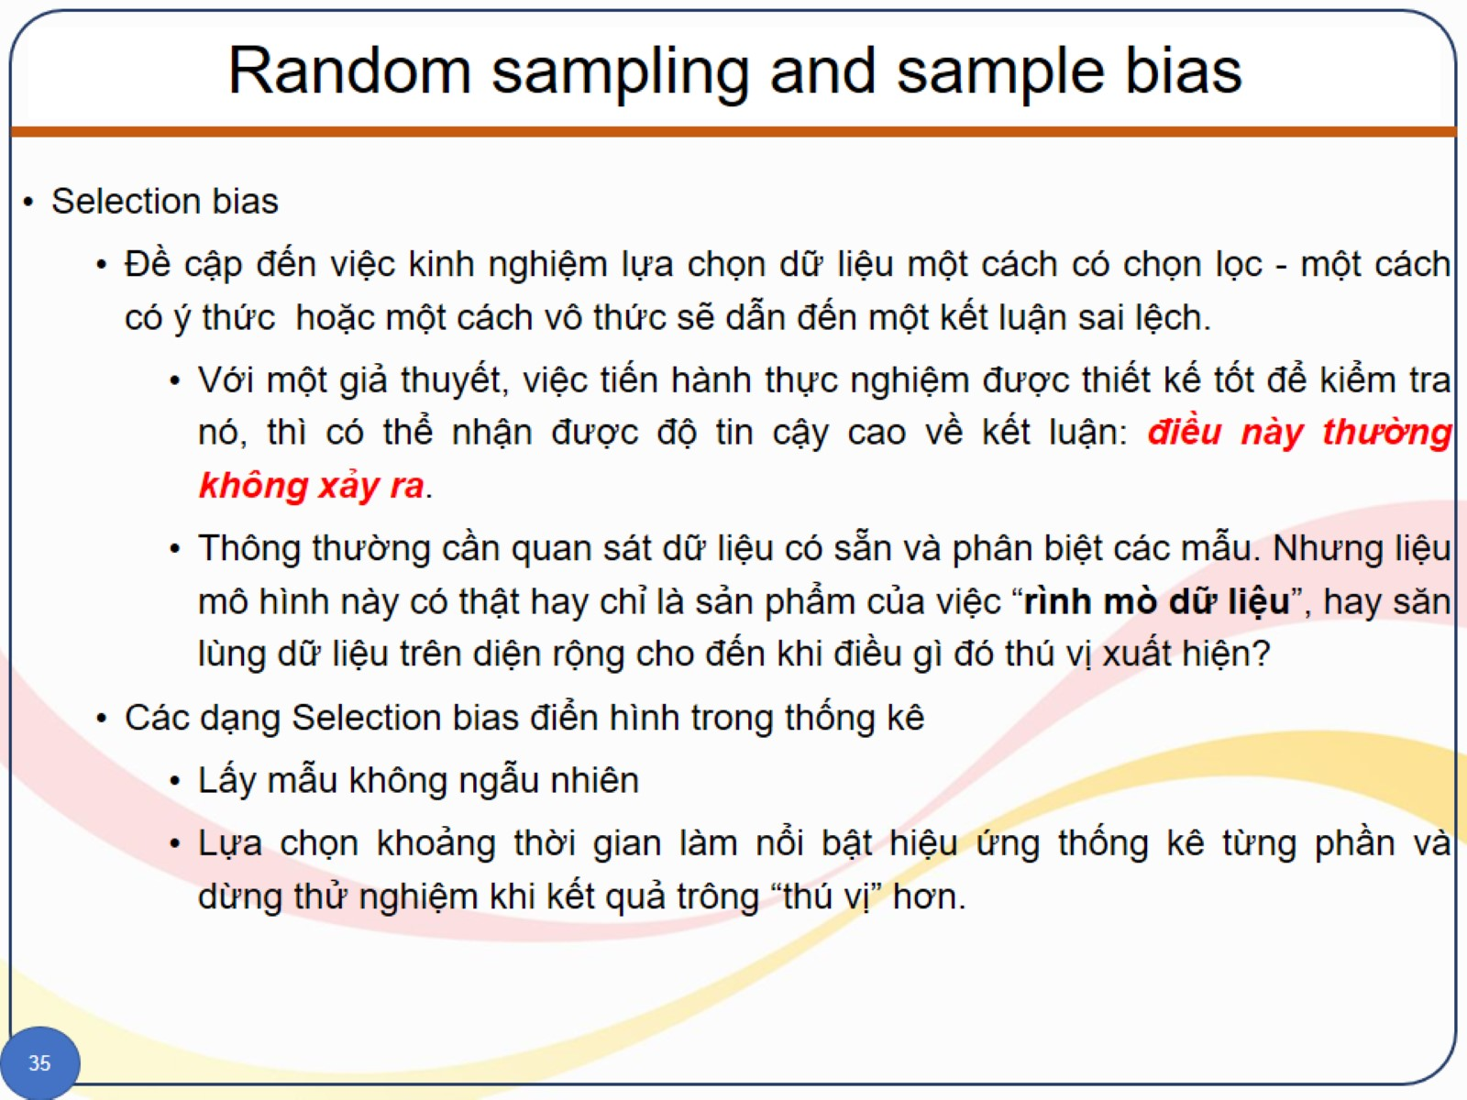
Random sampling and sample bias

Slide 43
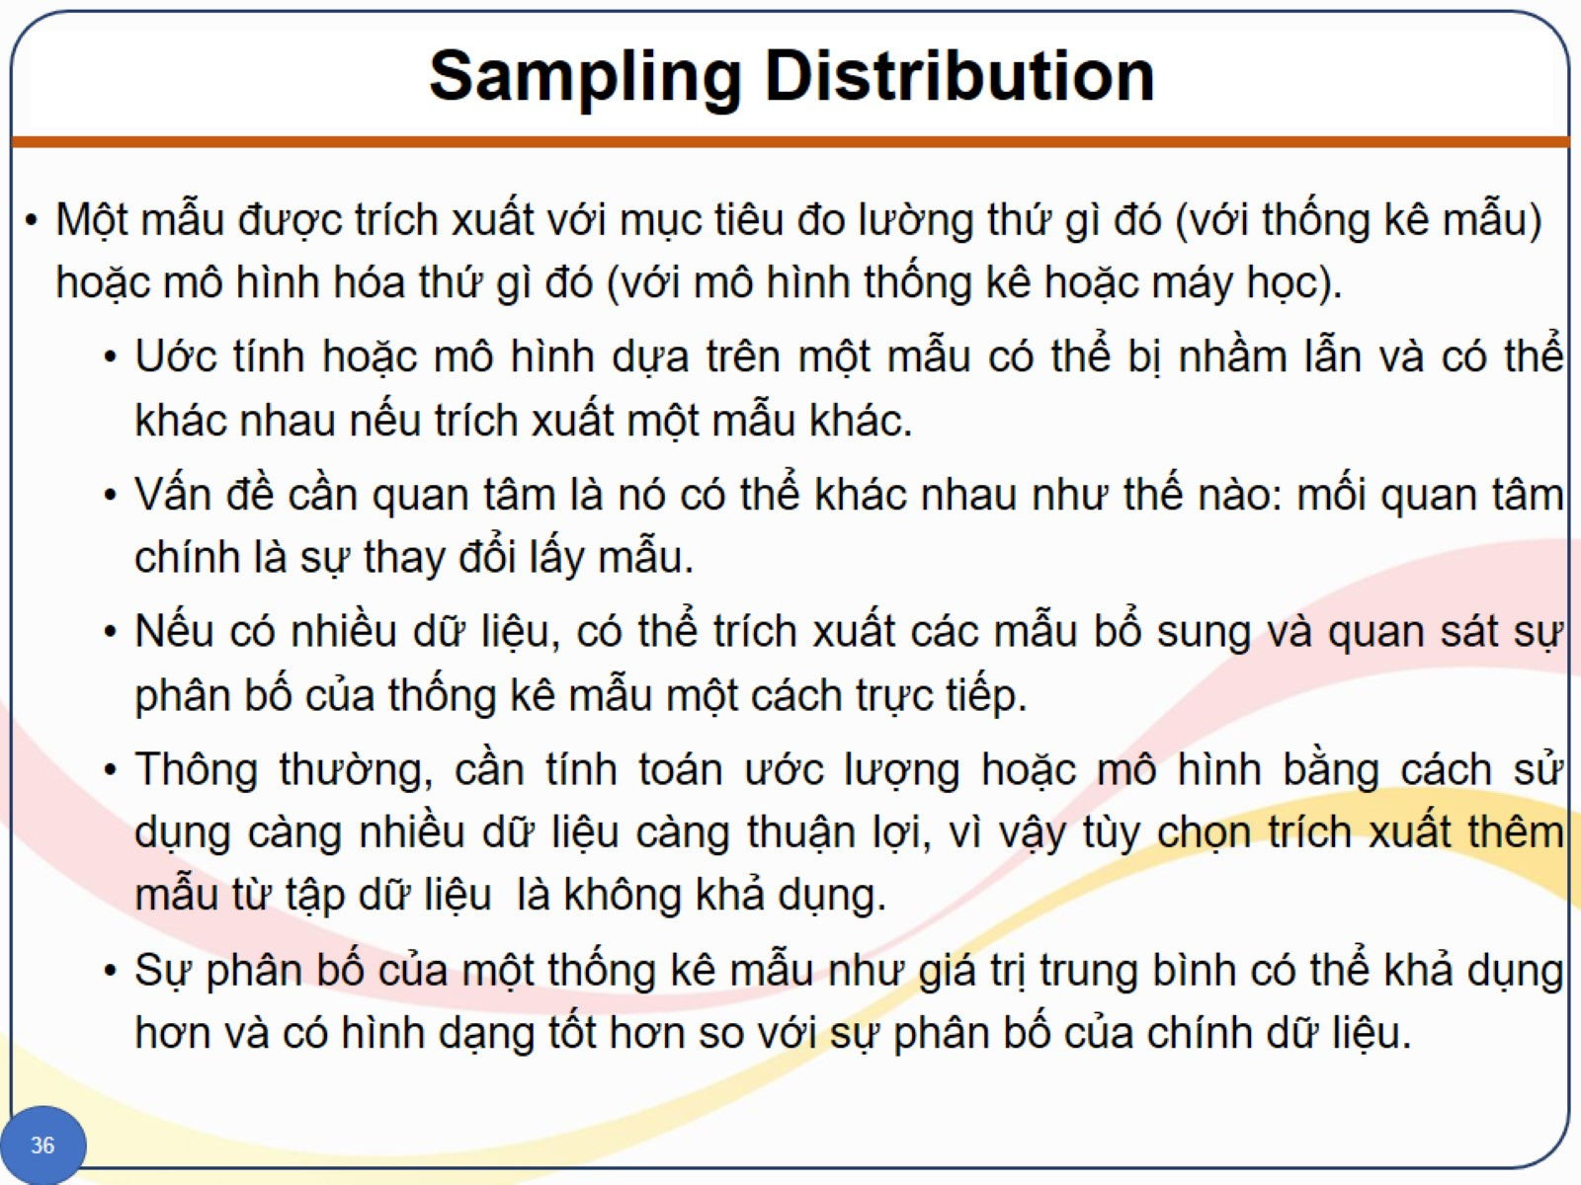
Sampling Distribution

Slide 44
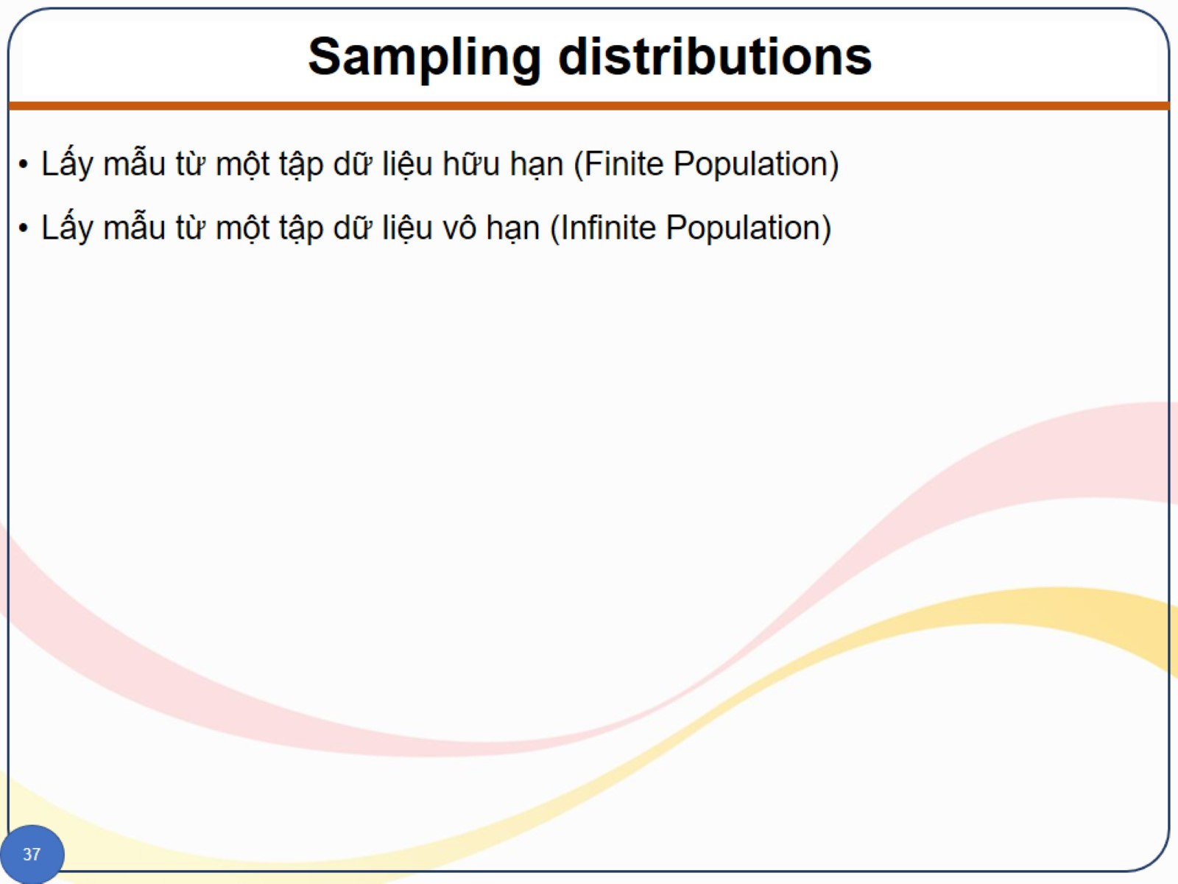
Sampling distributions

Slide 45
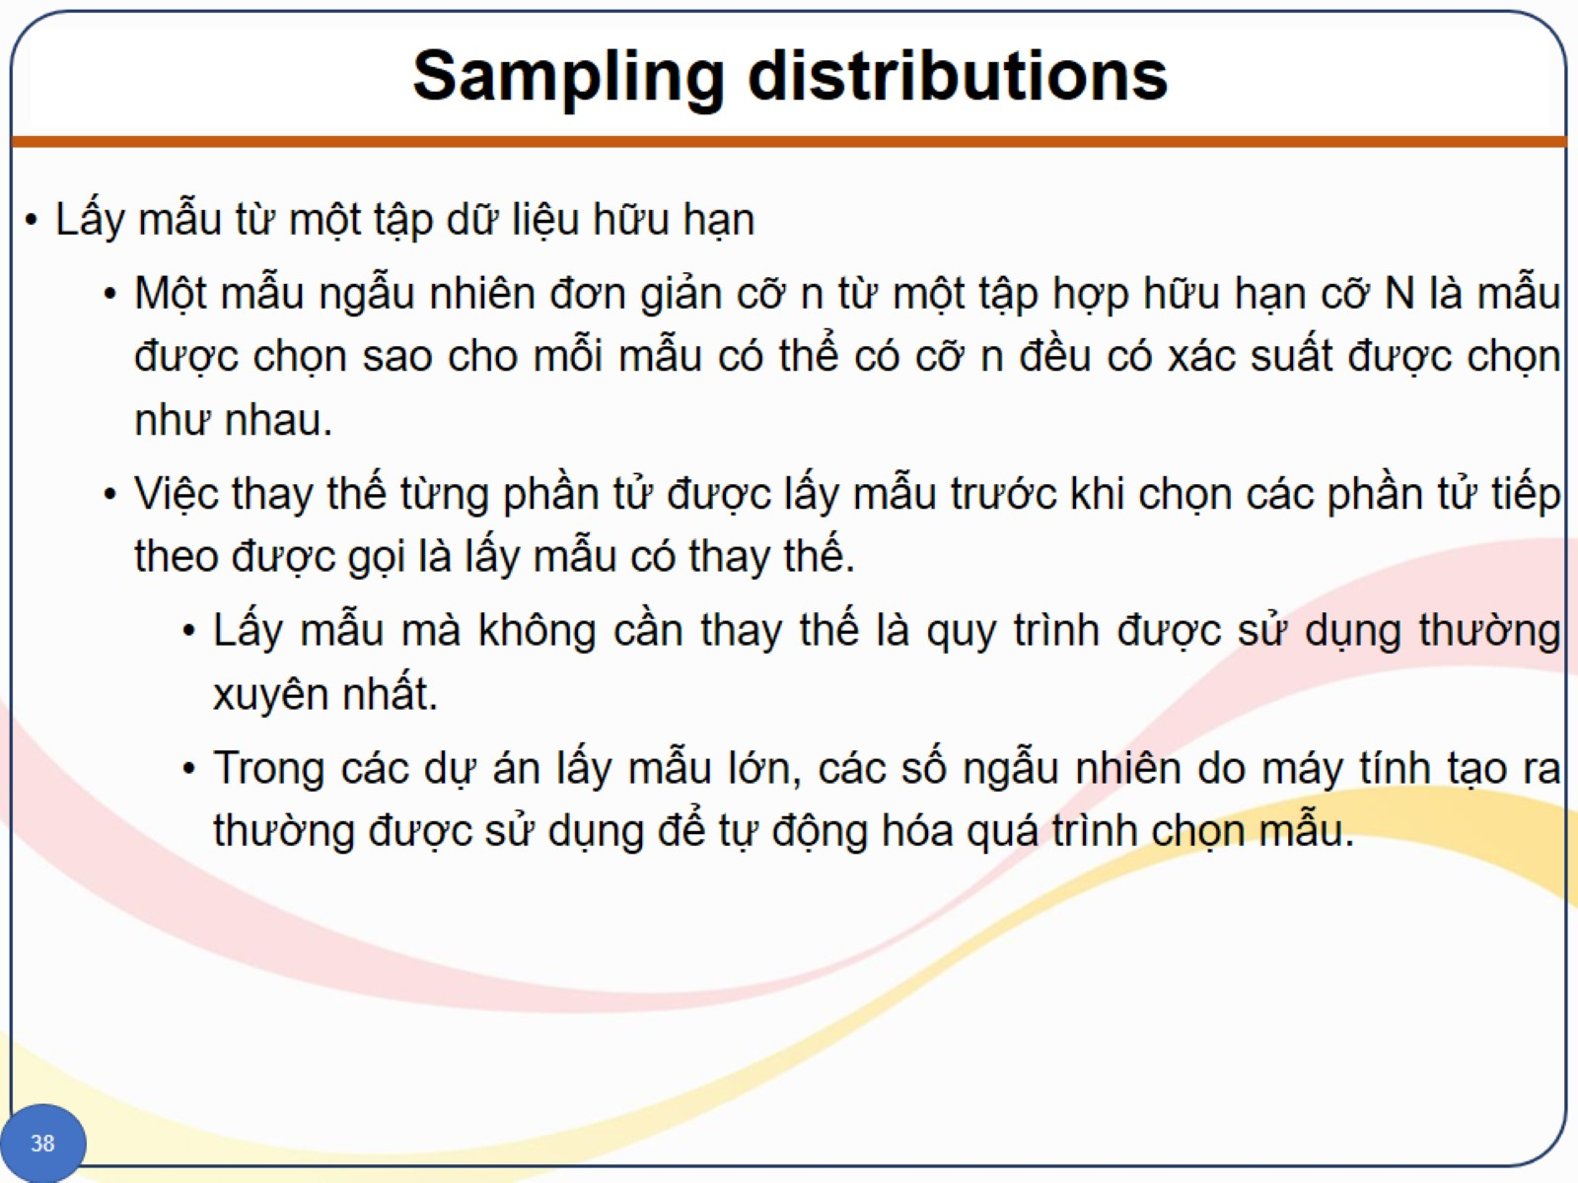
Sampling distributions

Slide 46
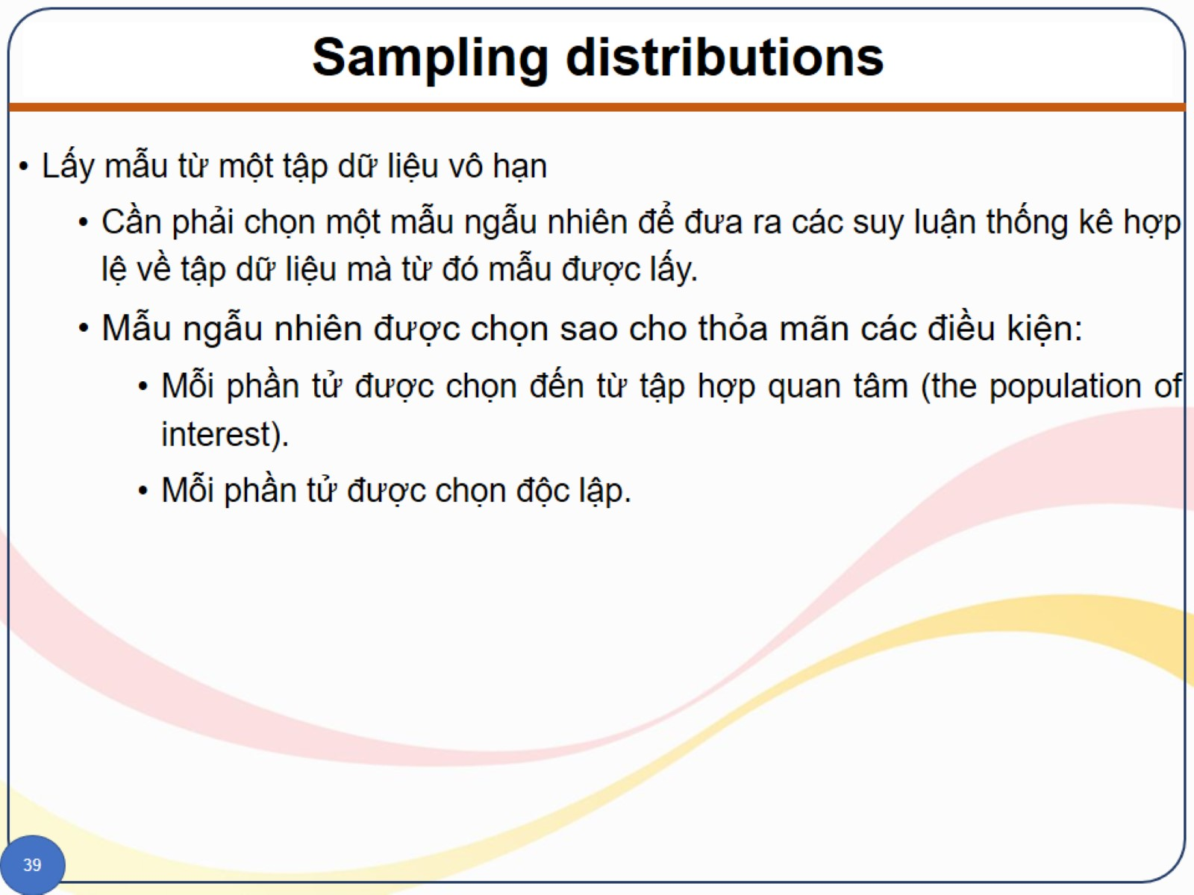
Sampling distributions

Slide 47
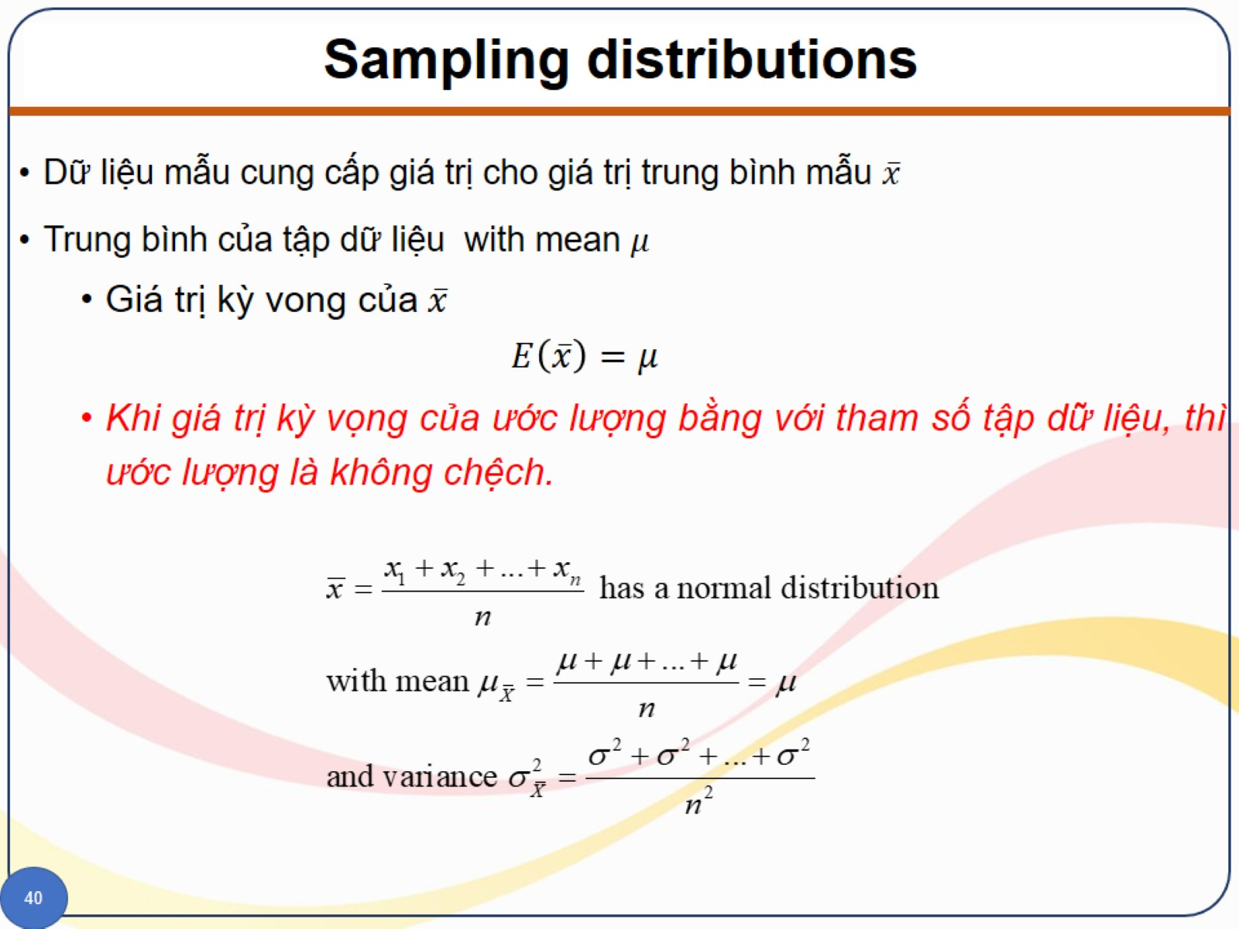
Sampling distributions

Slide 48
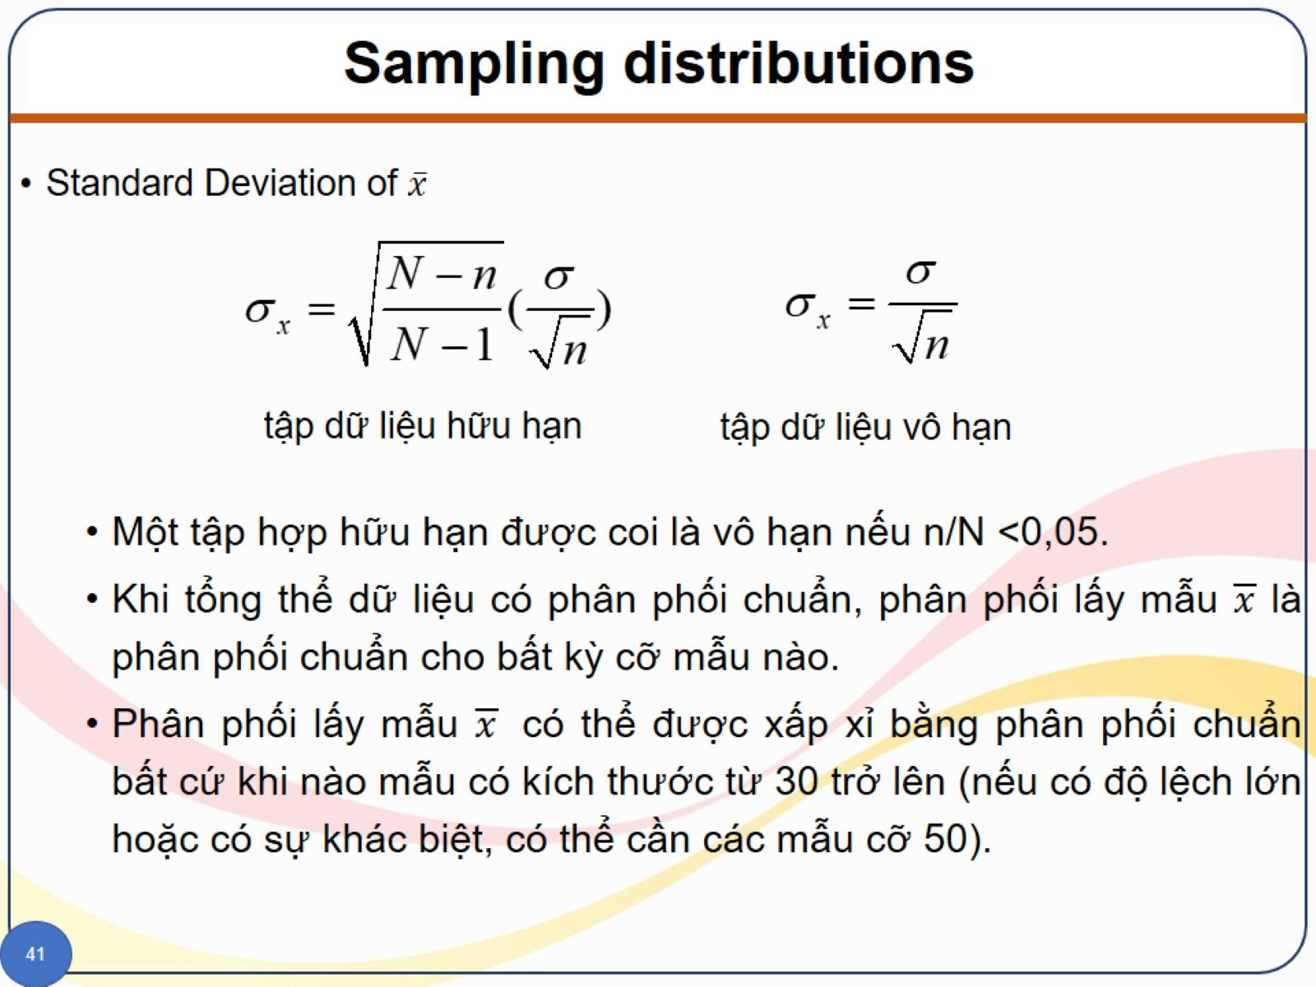
Sampling distributions

Slide 49
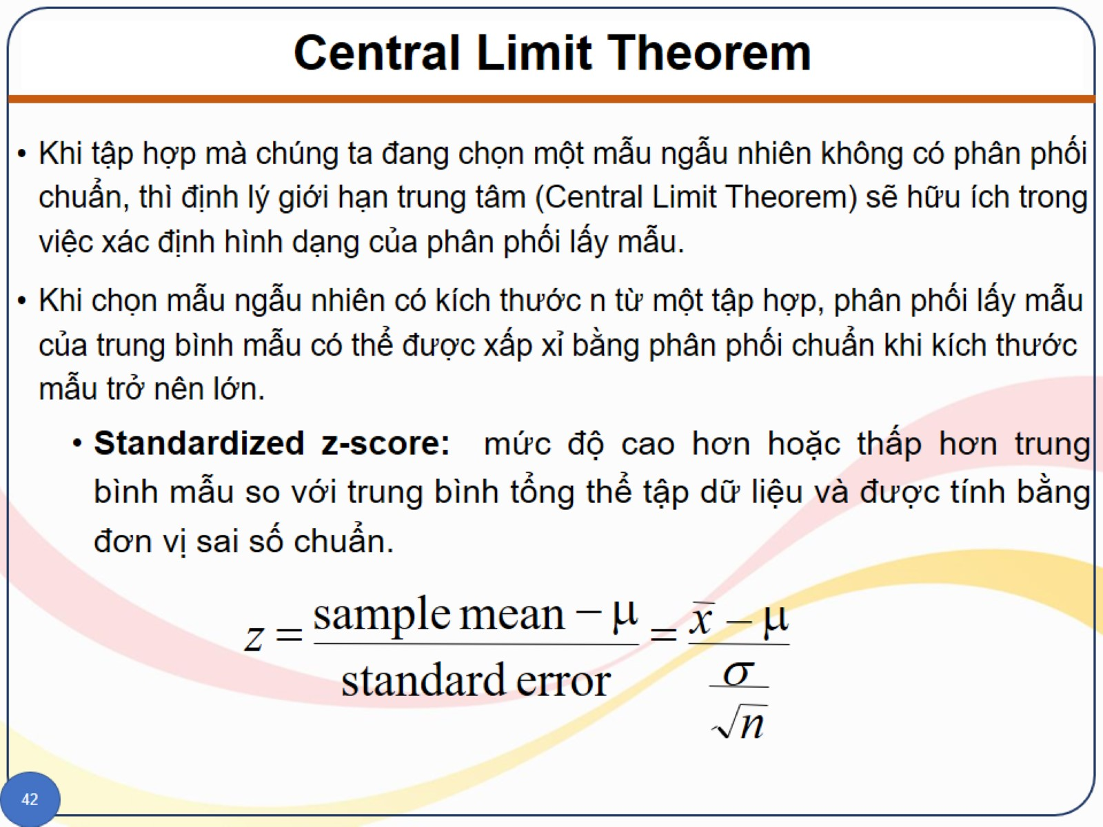
Central Limit Theorem

Slide 50
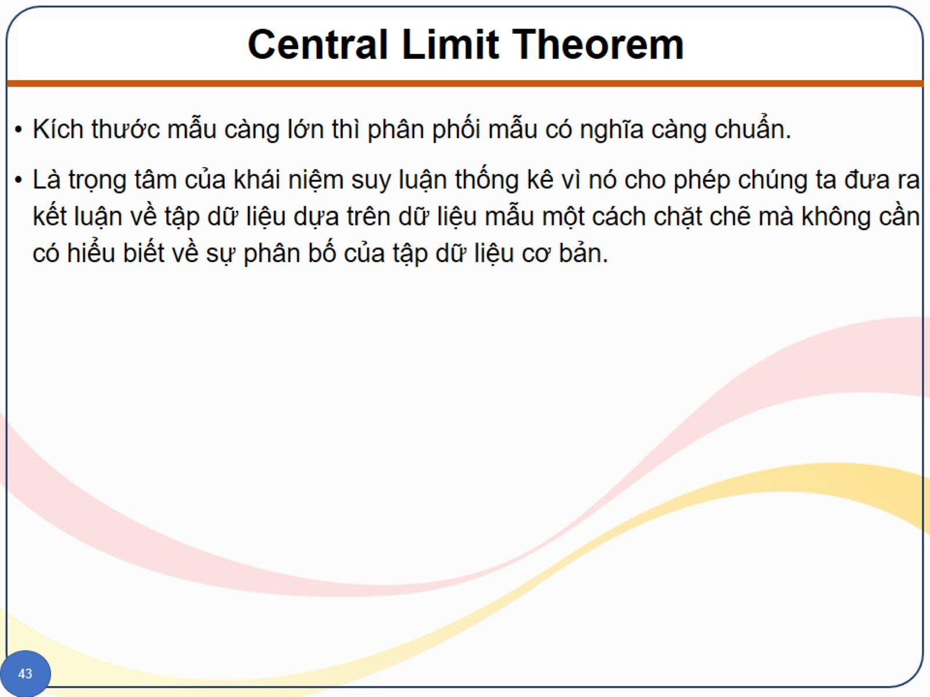
Central Limit Theorem

Slide 51
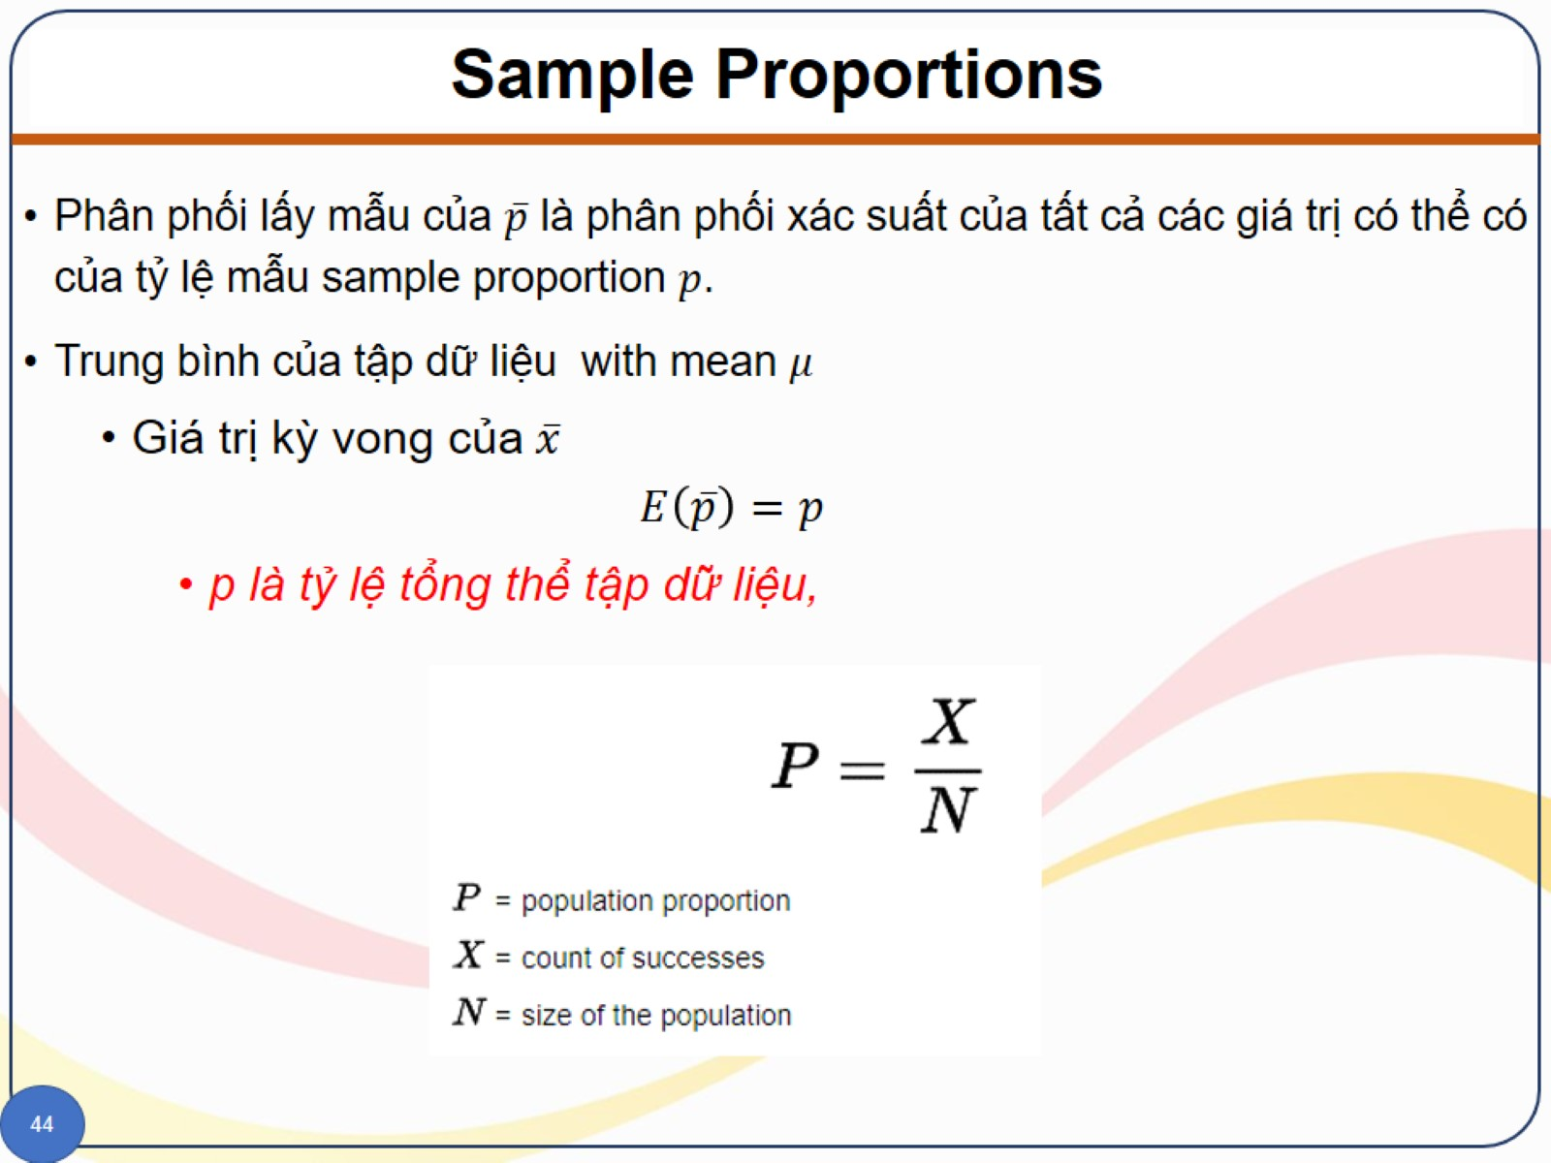
Sample Proportions

Slide 52
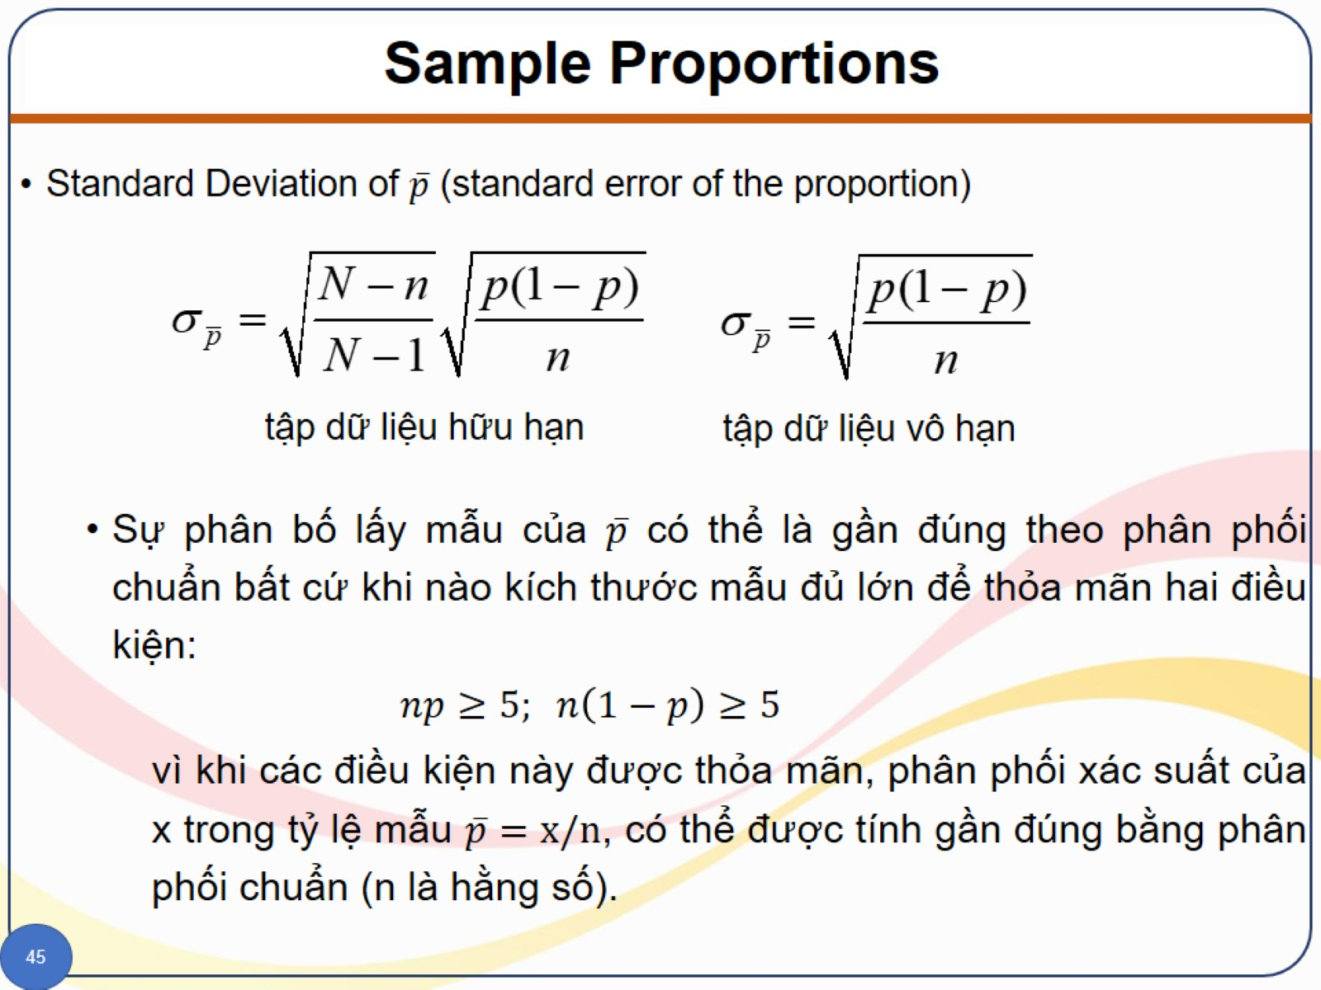
Sample Proportions

Slide 53
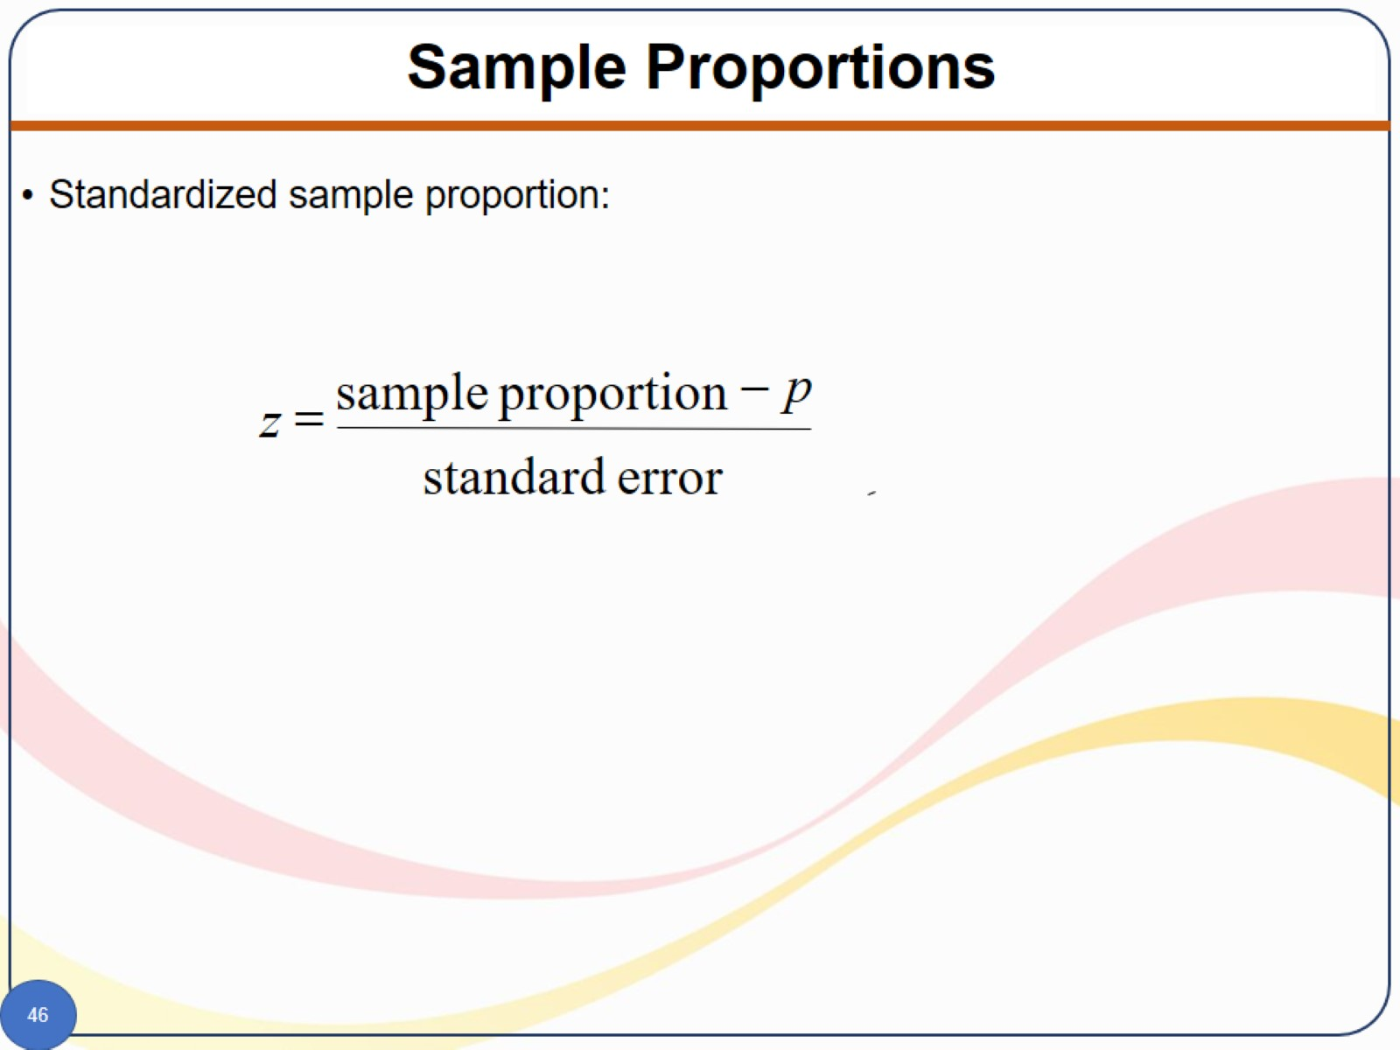
Sample Proportions

Slide 54
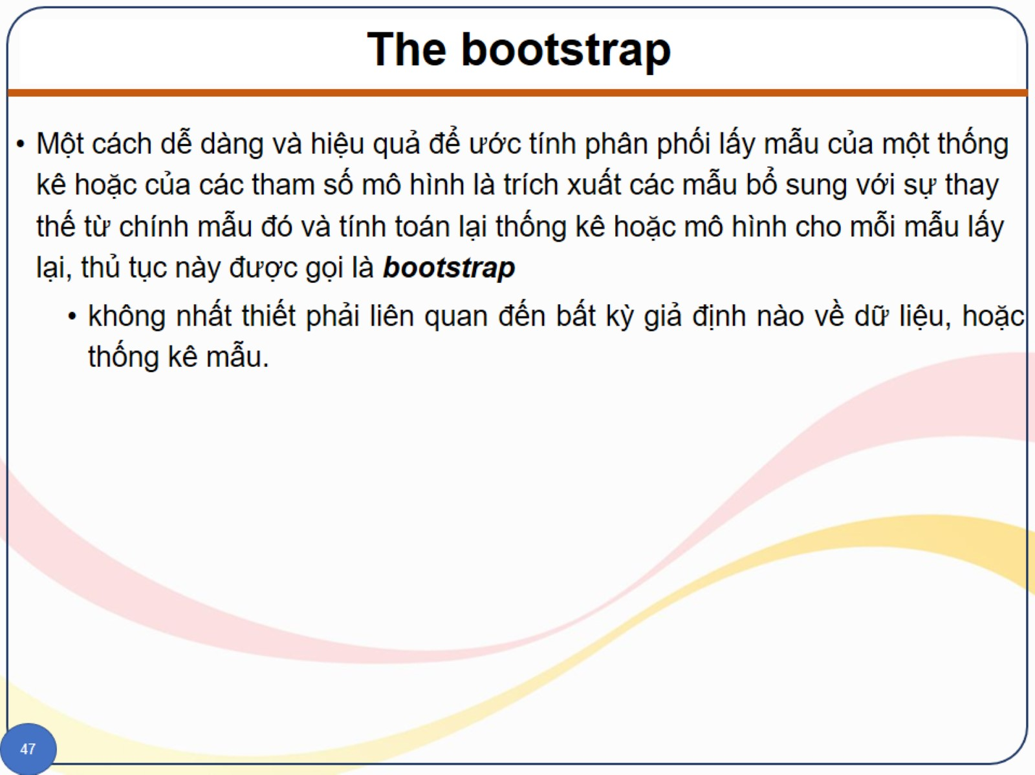
The bootstrap

Slide 55
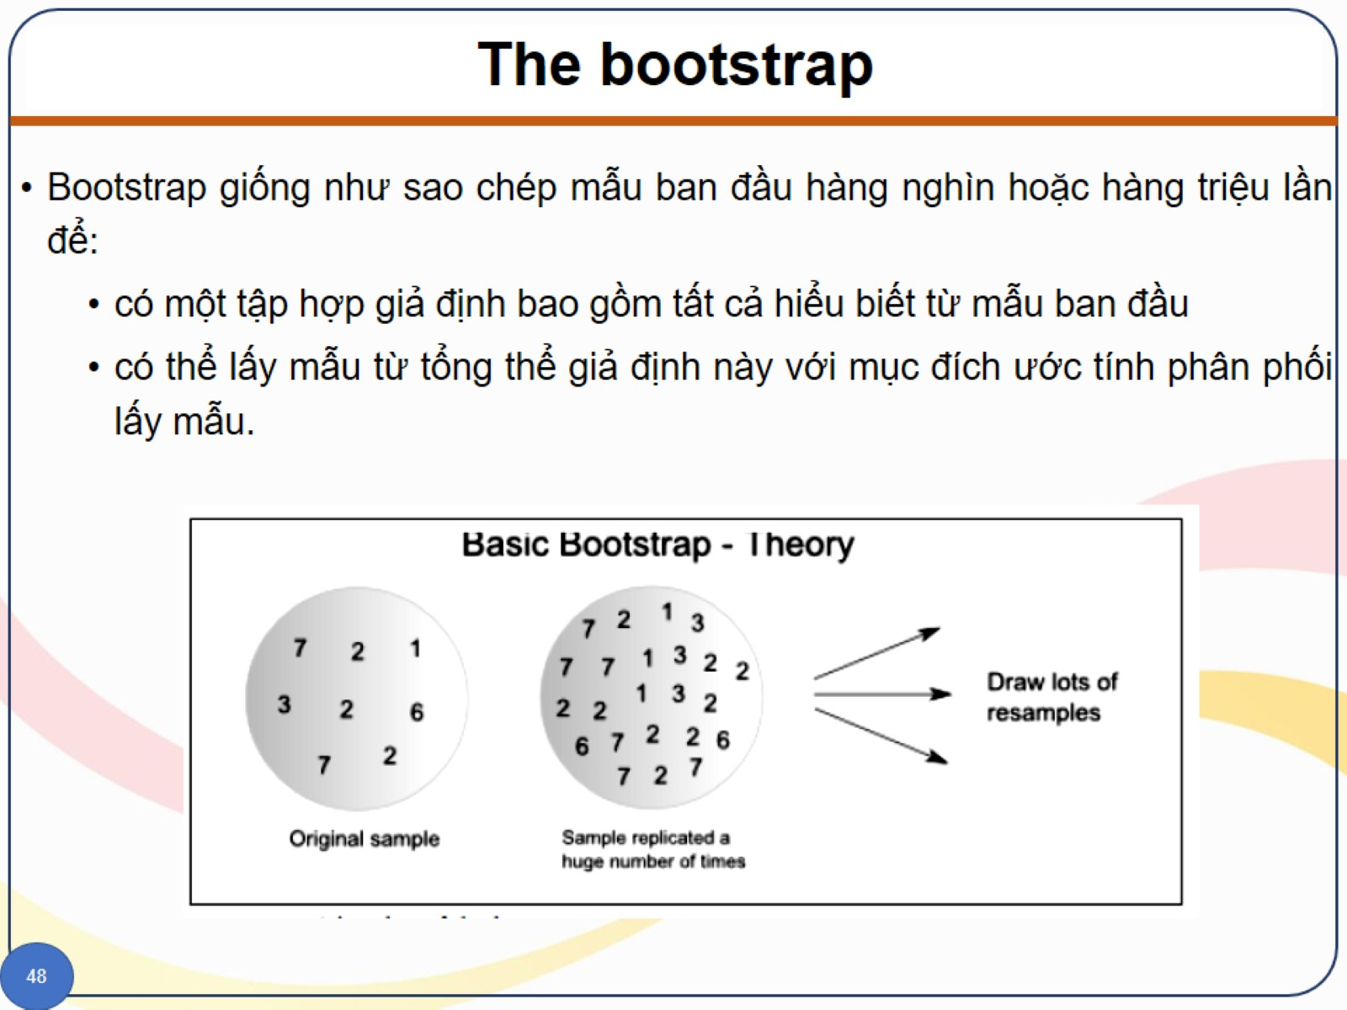
The bootstrap

Slide 56
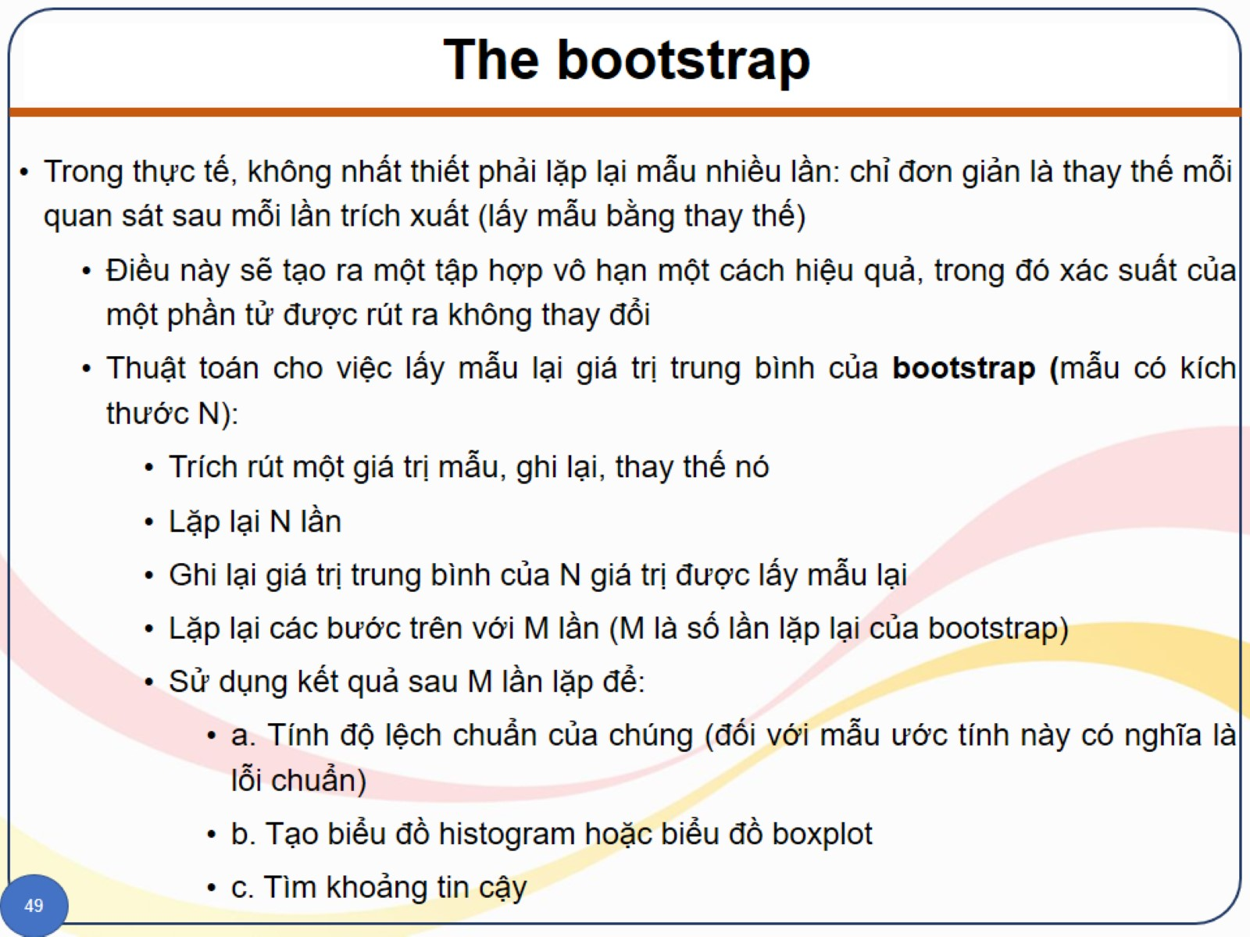
The bootstrap

Slide 57
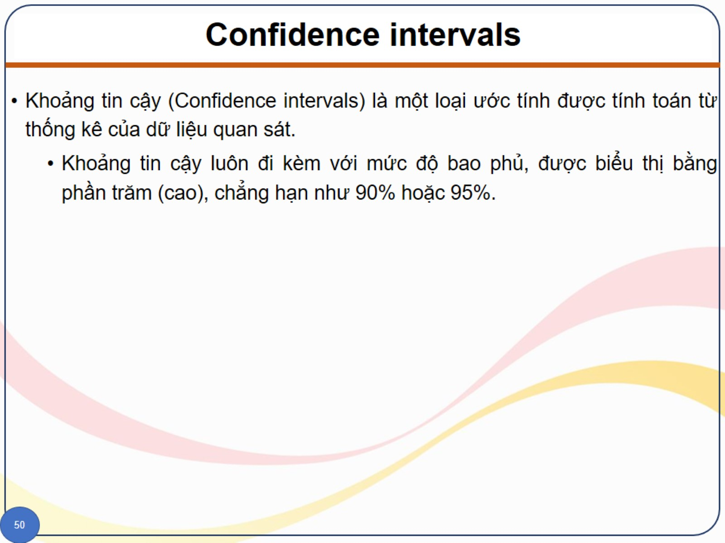
Confidence intervals

Slide 58
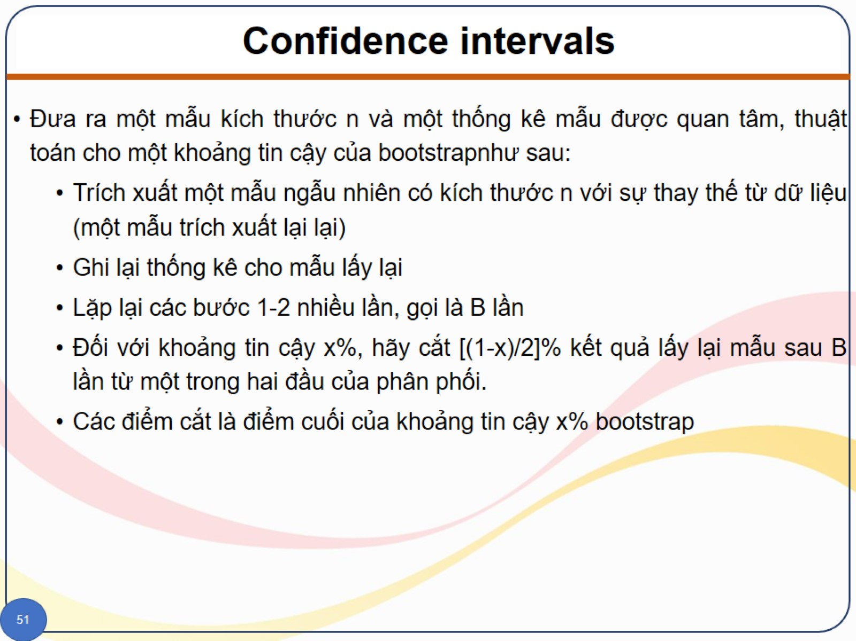
Confidence intervals

Slide 59

Confidence intervals

Slide 60

Distribution

Slide 61

Distribution

Slide 62

Distribution

Slide 63

Distribution

